Slide 1
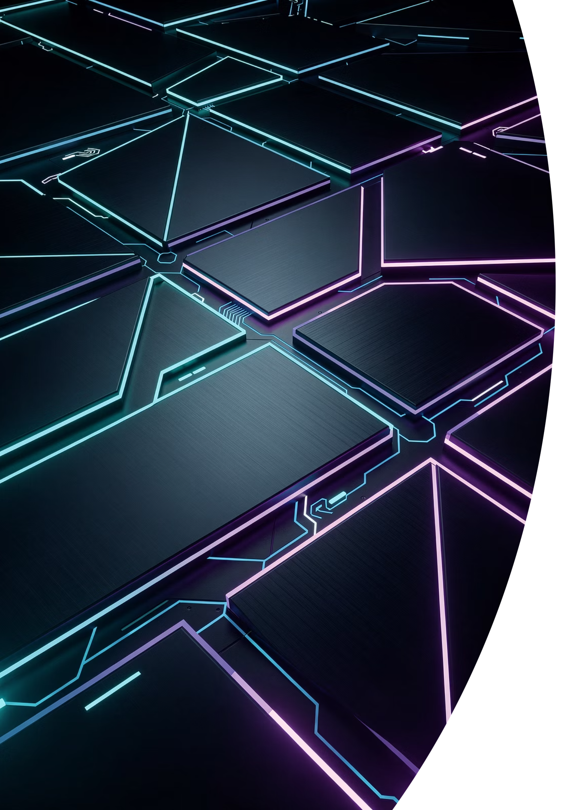
APGC v0.1 — Artifact Panel Geometry Contract
The formal geometry language for Aptlantis Studio interface artifacts — defining shape families, angle energy, corner profiles, safe zones, and manga-inspired panel composition for deterministic SVG and HTML generation.
DRAFT V0.1
APTLANTIS STUDIO
SESM · NIPC · AIC · NEON INK

Slide 2

What APGC Solves
Shape as a First-Class Design Layer
Aptlantis Studio panels are not limited to squares and rectangles. Many panels may be four-sided shapes with slanted edges, asymmetric corners, trapezoid-like forms, manga-inspired compositions, cut-corner containers, and shard accents. Without a contract, generators improvise — producing geometry drift across artifacts.
Shape
Color
Communicates visual rhythm, energy, and composition
Communicates semantic role — governed by NIPC
State
Metadata
Controls intensity — governed by AIC
Carries meaning — governed by SESM
APGC makes those shapes deterministic rather than random — alive without compromising clarity, accessibility, archive-friendliness, or deterministic generation.

Slide 3
Chapter 1 — Architecture
Relationship to the Existing Spec Stack
APGC is a geometry layer that sits beside — not above or below — SESM, NIPC, AIC, and Neon Ink. Each spec owns a distinct concern. APGC gives generators and design agents a formal way to decide geometry without overriding any other layer.
Layer / Spec
Responsibility
What it answers
SESM
Embedded metadata, asset identity, provenance
What is this artifact? Where did it come from?
NIPC
Semantic color families, psychological intent, hue rules
What does the hue mean? How intense is the neon?
AIC
Artifact types, required fields, layout regions
What artifact type is this? Which fields are required?
Neon Ink
Brand system, typography, panel grammar, page composition
What should Aptlantis Studio feel like?
APGC
Shape families, corner behavior, angle energy, safe zones
What shape should a panel use? How angular may it be?

Slide 4

Chapter 2 — Goals & Philosophy
Design Goals & Non-Goals
APGC Is Designed To
APGC Does Not
Prevent geometry drift across generated SVG and HTML artifacts
Make manga-inspired panel design deterministic and reusable
Support non-rectangular four-sided panels without sacrificing readability
Define shape families that communicate visual energy
Preserve safe text regions inside angled or asymmetric panels
Give design agents and build agents explicit geometry rules
Allow expressive layouts while preserving archive-grade structure
Define color semantics — that is NIPC's domain
Replace AIC artifact contracts or SESM metadata
Require every artifact to be non-rectangular
Require manga-style geometry everywhere
Require JavaScript or animation
Make geometry the only carrier of meaning
Define full page routing or content strategy

Slide 5


Design Philosophy
Manga Energy Without Manga Confusion
Manga panel composition uses angled quadrilaterals, irregular gutters, dynamic cuts, and strong visual rhythm. Aptlantis Studio borrows the useful parts while guarding against the confusing ones.
Borrow: Motion & Energy
Avoid: Unreadable Text Regions
Diagonal reading flow, section rhythm, dramatic framing, hierarchy, expressive information architecture.
Random angles that push text into clipped corners must never occur in production artifacts.
Borrow: Visual Hierarchy
Scale variation, asymmetric composition, directional slants that guide the eye across the artifact surface.
Avoid: Excessive Fragmentation
Unclear reading order, too many competing focal points, and arbitrary polygon generation undermine the system.
Shape is rhythm, not truth. A slanted panel may suggest forward motion. But error must still be represented by semantic state and text — never by shape alone.

Slide 6
Chapter 3 — Shape Families
Canonical Shape Families
Shape family is the primary geometry classification. Twelve families are defined in APGC v0.1, ranging from energy level 0 (calm rectangles) to level 5 (rare visual interrupts). Generators must select only from this list — not improvise.
Shape Family
Energy
Meaning
Best Use
rect-stable
0
Stability, neutrality, dense readability
Docs, tables, metadata, long text
soft-card
0–1
Friendly artifact card
Dataset cards, Q&A items, ordinary panels
cut-corner
1–2
Technical, compiled, artifact-like
Schema cards, download cards, generated artifacts
slant-forward
1–3
Motion, progress, next step
Pipelines, navigation, process flow
slant-back
1–3
History, archive, reflection
Changelog, snapshots, prior versions
trapezoid-wide
1–3
Section identity, banner energy
Headers, hero strips, category panels
manga-panel-a
2–3
Dynamic but readable
Featured sections, section mosaics
manga-panel-b
3–4
Strong asymmetry
Hero mosaics, visual-first panels
manga-panel-c
4
Dramatic composition
Rare campaign or splash surfaces
shard
1–4
Small angular accent
Badges, labels, pointer marks
burst
4–5
Interrupt, spotlight, dramatic emphasis
Rare hero/alert graphics only

Slide 7

Chapter 4 — Angle Energy
The Angle Energy Scale
Angle energy is a numeric measure of how visually dynamic or angular a panel is. Higher energy means stronger slants, more asymmetry, and more dramatic composition. The scale runs from 0 (rectangular, quiet) to 5 (rupture, visual interrupt).
0 — Rectangular
Stable, grid-aligned. Dense content, docs, metadata.
1–2 — Technical / Editorial
Cards, schema panels, Q&A, feature cards. Text must remain in safe zone.
3–4 — Dynamic / Dramatic
Visual sections, hero mosaics, marketing surfaces. Low text density required.
5 — Rupture
Rare alerts and splash graphics only. Never use with dense text.
Maximum Energy Rule: No artifact with long body text should exceed angle_energy: 2 unless the text is fully contained inside a verified inner safe zone.

Slide 8
Chapter 5 — Directional Semantics
Skew Direction & Reading Flow
Geometry may imply direction, but it must remain secondary to explicit labels, color, state, and metadata. For English-language Aptlantis Studio pages, forward motion should guide the eye from top-left → center → lower-right.
forward
back
upward
Continue, progress, next step. Use for pipelines, navigation, actions.
History, prior state, archive. Use for snapshots, changelog, older releases.
Growth, elevation, spotlight. Use for featured metrics, improvement dashboards.
inward
mixed
Focus, convergence. Use for summary panels, synthesis, canonical answers.
Manga composition rhythm. Use for hero mosaics only — not standard artifact panels.

Slide 9

Chapter 6 — Corner Profiles
Corner Profiles & Offset Limits
Corner profile defines how the corners of a panel are shaped. Ten canonical profiles are defined, ranging from plain archival square corners to full manga-irregular geometry. Generators must select from this list only.
Corner Offset Limits by Density
Density
Max Offset
Corner Profile
Meaning
Best Use
dense
12px
square
Stable, archival
Docs, tables
compact
20px
soft-radius
Friendly
Cards, Q&A
standard
32px
single-cut
Technical accent
Badges, utility panels
spacious
48px
dual-cut
Artifact feel
Download, schema cards
hero
72px
visual-only
120px
opposite-cut
Motion/balance
Navigation panels
asymmetric-soft
Manga-like readable
Feature, section panels
Corner offset must never intrude into the inner safe zone — a validation failure condition.
asymmetric-sharp
Higher drama
Hero support panels
manga-irregular
Full manga
Visual mosaics

Slide 10
Chapter 7 — Safe Zones
Inner Safe Zones Are Mandatory
Safe zones are mandatory for all non-rectangular panels that contain text, numbers, controls, or important icons. Text may not render outside the safe zone. The safe zone type varies by use case.
full-rect
Entire panel is text-safe. Used for rectangular panels only.
inset-rect
Inner rectangle inside a shaped panel. The default for most artifact panels.
center-band
Horizontal safe band for hero banners and title strips.
stat-grid
Grid-safe regions for numbers and stats panels with predictable cell positions.
visual-only
No text safety guaranteed. Decorative images and abstract shards only.

Slide 11
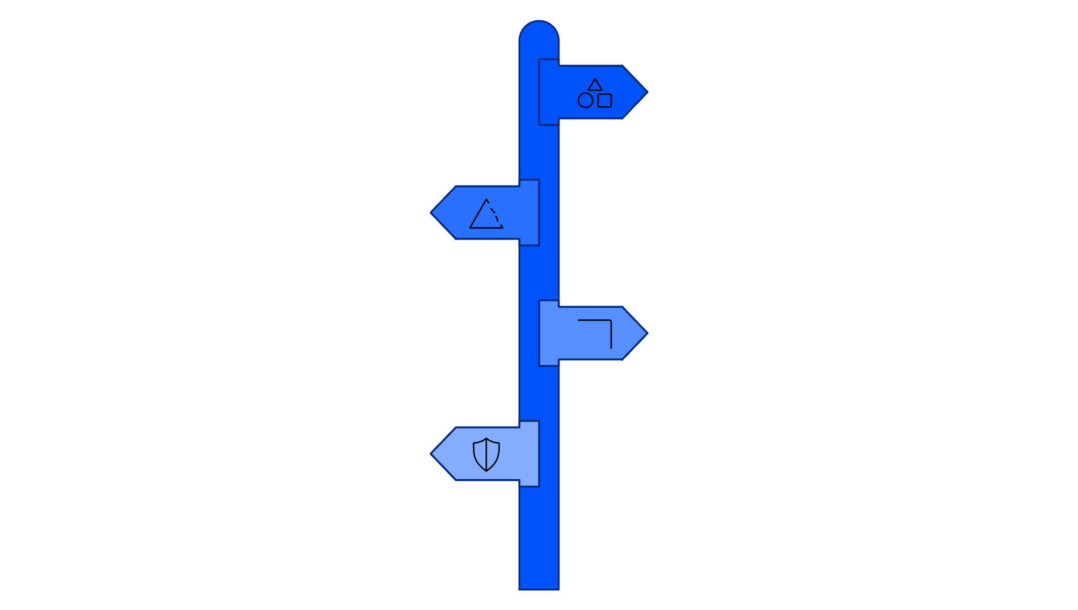
Chapter 8 — Core Geometry Model
Five Geometry Decisions
Every APGC-governed panel is defined by exactly five orthogonal decisions. This object structure is the recommended representation in AIC contracts, SESM metadata, and generator templates.
Shape Family
Select base geometry class for panel layout.
Angle Energy
Define angular weighting and curvature intensity.
Corner Profile
Specify corner rounding or chamfer geometry.
Safe Zone
Set margins to preserve critical geometry.
These five decisions form a deterministic chain: given the same artifact type, density, and theme version, a generator should produce identical geometry every time unless a seed or override is explicitly provided. Determinism is a first-class requirement.
{
"geometry": {
"contract": "apgc-0.1",
"shape_family": "manga-panel-a",
"angle_energy": 2,
"corner_profile": "asymmetric-soft",
"safe_zone": { "type": "inset-rect", "x": 32, "y": 28,
"width": 536, "height": 164 },
"responsive_fallback": "soft-card"
}
}

Slide 12

Chapter 9 — SVG & HTML Geometry
SVG-First Artifact Generation
SVG is the canonical render target for APGC because Aptlantis Studio treats many interface units as compiled SVG artifacts. Polygon points are expressed in clockwise order. HTML surfaces may use CSS clip-path as an equivalent.
SVG Quadrilateral (Clockwise)
CSS clip-path Equivalent
<polygon
points="0,16 580,0 600,204 20,220"
fill="#111827"
stroke="#22D3EE"
stroke-width="2"
/>
<!-- top-left → top-right
→ bottom-right → bottom-left -->
.apgc-manga-panel-a {
clip-path: polygon(
0% 7%,
96.7% 0%,
100% 92.7%,
3.3% 100%
);
}
Preferred SVG Primitives
Responsive Breakpoints
<polygon> — simple four-sided shapes
<path> — cut-corner or mixed geometry
<clipPath> — image/content masks
<metadata> — SESM/APGC embedding
Width
Geometry
≥ 1200px
Full geometry allowed
900–1199px
Reduce offsets by 20%
640–899px
Reduce offsets by 40%
< 640px
Fallback to soft-card
Focus Rule: If a clipped panel contains links or buttons, focus outlines must remain visible and must not be clipped beyond recognition. Use an outer wrapper for focus and an inner clipped panel for shape.

Slide 13
Chapter 10 — Shape Selection
Shape Selection by Artifact Type
AIC artifact type contracts should reference APGC for geometry decisions. Each artifact type has a recommended default shape, a set of allowed families, and a maximum angle energy ceiling.
AIC Artifact Type
Default Shape
Allowed Families
Max Energy
dataset-card
soft-card
soft-card, cut-corner, manga-panel-a
2
dataset-header
trapezoid-wide
rect-stable, trapezoid-wide, manga-panel-a
3
pipeline-panel
slant-forward
cut-corner, slant-forward, manga-panel-a
3
qa-item
soft-card
soft-card, cut-corner, slant-forward
2
stats-tile
rect-stable
rect-stable, soft-card, cut-corner
2
theme-board
manga-panel-a
trapezoid-wide, manga-panel-a, manga-panel-b
4
download-card
cut-corner
cut-corner, slant-forward
2
schema-card
cut-corner
rect-stable, cut-corner
2
archive-summary
slant-back
rect-stable, soft-card, slant-back
2
brand-promo-panel
manga-panel-b
manga-panel-a, manga-panel-b, burst
5

Slide 14
Chapter 11 — Manga Mosaics
Manga Mosaic Composition
A manga mosaic is a group of APGC panels arranged as a section, hero, or visual explainer. Mosaics must create visual rhythm, preserve reading order, vary panel scale intentionally, and use asymmetry without randomness.
manga-grid-a
manga-grid-b
Balanced feature sections. Large primary panel left/top, 2–4 supporting panels right/bottom, moderate slants, clear safe zones.
Energetic sections. Large angled hero panel, varied-height supports, stronger diagonal gutters, limited body text.
hero-split-diagonal
rail-and-stack
Page headers. Left identity block, right visual/artifact block, diagonal divider, center-band safe zone.
Sections with side navigation. Thin vertical trapezoid rail, stacked content panels, small shards for status markers.
archive-strip
pipeline-flow
Timelines, snapshots, changelogs. Mostly rectangular panels, slant-back accents, muted geometry, horizontal reading flow.
Pipeline explainers. Forward-slanted stages, violet process accents, orange execution shards, green verification endpoint.

Slide 15
Chapter 12 — Validation
Validation Rules for Generators
Generators should validate APGC fields before output. Six fields are required for every production artifact. Validators should check both failure conditions and emittable warnings.
Required Fields
contract
shape_family
angle_energy
corner_profile
safe_zone
responsive_fallback
For decorative assets,

Slide 16
Chapter 13 — Generator Resolution
Generator Resolution Order
A generator receiving APGC-governed artifact requests must follow a deterministic resolution chain. Given the same inputs — source data, artifact type, theme version, shape family, angle energy, and viewBox — the output geometry must be identical every time.
01
02
Read Artifact Type
Read Semantic Role & State
Load from AIC contract to determine allowed shape families and maximum energy.
Load from NIPC/AIC/SESM data to constrain geometry based on meaning.
03
04
Determine Density
Choose Shape Family & Clamp Energy
Classify as dense, compact, standard, spacious, hero, or visual-only to set energy ceiling and corner offset limit.
Select shape family and clamp angle_energy to the allowed range for both artifact type and density level.
05
06
Calculate Polygon & Safe Zone
Render & Embed Metadata
Compute outer polygon, inner safe zone, and validate that corner offsets do not intrude into the safe zone.
Render SVG or HTML, embed APGC fields in <metadata> or SESM vendor extension, and run the validator.

Slide 17

Chapter 14 — Polygon Presets
Recommended Polygon Presets
These presets assume a 600×220 viewBox and are the canonical starting points for generators. Safe zone coordinates are pre-calculated to guarantee text never escapes the inner rectangle.
Shape Family
Outer Polygon Points
Safe Zone (x, y, w, h)
rect-stable
[[0,0],[600,0],[600,220],[0,220]]
x:24 y:24 w:552 h:172
cut-corner
[[0,0],[576,0],[600,24],[600,220],[24,220],[0,196]]
x:32 y:28 w:536 h:164
slant-forward
[[24,0],[600,0],[576,220],[0,220]]
x:48 y:26 w:504 h:168
slant-back
[[0,0],[576,0],[600,220],[24,220]]
x:48 y:26 w:504 h:168
trapezoid-wide
[[36,0],[564,0],[600,220],[0,220]]
x:56 y:30 w:488 h:160
manga-panel-a
[[0,16],[580,0],[600,204],[20,220]]
x:36 y:30 w:528 h:158
manga-panel-b
[[20,0],[600,28],[560,220],[0,192]]
x:56 y:42 w:488 h:136
shard
[[0,8],[92,0],[108,32],[14,40]]
x:14 y:8 w:78 h:24
All points expressed in clockwise order: top-left → top-right → bottom-right → bottom-left. Deviation from clockwise order will fail SVG rendering validation.

Slide 18
Chapter 15 — Accessibility & Density
Accessibility & Density Rules
Accessibility Mandates
Density × Energy Constraints
Non-rectangular panels must preserve all of the following regardless of angle energy:
Density
Max Energy
Safe Zone
Text contrast
dense
1
Required
Glow and bleed effects must never reduce contrast within the safe zone.
compact
2
Required
standard
2
Required
Focus visibility
spacious
3
Required
Focus outlines must not be clipped. Outer wrapper receives focus; inner panel receives shape.
hero
4
Required for text
Reading order
visual-only
5
Optional
DOM order must follow reading order even when CSS repositions panels visually.
Long Text Rule: Any panel with body text longer than 240 characters must use rect-stable or soft-card at energy 0–1.
Shape-only meaning
Error, warning, verified, and deprecated status must never be communicated by shape alone.

Slide 19
Chapter 16 — Metadata & Overrides
APGC Metadata Placement & Override Policy
APGC fields may appear in AIC artifact contracts, SESM ui hints, SESM vendor extension fields, generator templates, JSON/TOML theme config, and SVG <metadata> blocks. Overrides are allowed but must be visible and rare.
Full Vendor Extension Pattern
Override Policy
{
"extra": { "vendor": { "aptlantis": {
"apgc": {
"contract": "apgc-0.1",
"shape_family": "manga-panel-a",
"angle_energy": 2,
"skew_direction": "forward",
"corner_profile": "asymmetric-soft",
"safe_zone": {
"type": "inset-rect",
"x": 32, "y": 28,
"width": 536, "height": 164
},
"responsive_fallback": "soft-card"
}
}}}
}
Override Object
Valid Override Reasons
"geometry_override": { "enabled": true, "reason": "...", "approved_by": "design-system" }
Hero campaign visual
One-off infographic
Decorative splash asset
Experimental theme board
Archived legacy mockup
Template Naming Convention
{artifact_type}.{shape_family}.{density}.svg.tmpl
pipeline-panel.slant-forward.standard.svg.tmpl
theme-board.manga-panel-a.spacious.svg.tmpl
hero.manga-panel-b.hero.svg.tmpl

Slide 20

Summary
The Five-Layer Separation of Responsibilities
APGC makes shape a first-class part of the Aptlantis Studio design system. It allows the system to use manga-informed quadrilateral panels, slants, cuts, shards, trapezoids, and mosaics without drifting into arbitrary decoration — remaining deterministic, accessible, static-friendly, archive-aware, and generator-ready.
SESM
NIPC
AIC
Embedded meaning — identity, provenance, agent hints, links
Color meaning — hue, semantic family, psychological intent, intensity
Artifact structure — types, required fields, regions, render targets
Neon Ink
APGC
Brand expression — typography, voice, page rhythm, visual identity
Geometry rhythm — shape, corners, angles, safe zones, mosaics
Opinionated Default: Default panels are rectangles or soft cards. Geometry escalates purposefully — from stable utility panels through editorial slants to rare manga-panel hero surfaces — always guided by artifact type, density, and semantic role.

