Slide 1

NIPC — Neon Ink Palette Contract
The canonical color authority for Aptlantis Studio. This document defines semantic color families, token roles, psychological intent, intensity rules, and palette validation across generated artifacts, website UI, and brand surfaces.
NEON INK V0.1
AIC V0.1.X
SESM V0.2.X

Slide 2
The Core Principle
Color should reduce cognitive load before it adds beauty.
The beauty emerges from consistency. When users can read intent from color alone — without being taught — the system becomes a cognitive tool, not just a style guide. This principle governs every token, family, and rule in the NIPC.
Cyan
Green
Understand
Trust
Yellow
Red
Notice
Stop
Violet
Magenta
Process
Discover

Slide 3
Canonical Document Hierarchy
NIPC is the palette authority within a four-layer spec set. Each layer has a distinct responsibility — none overlap, and all interlock.
NeonInk v0.1
1
Brand system, typography, panel grammar, page composition, voice
AIC v0.1
2
Artifact types, required fields, layout regions, render targets — Expression
NIPC
3
Color families, semantic roles, psychological intent, intensity, validation — Contract
SESM v0.2
4
Embedded metadata, identity, provenance, links, agent hints — Meaning

Slide 4
Current System Strengths
The existing palette is already clean, functional, and strategically sound. It separates hue (semantic role) from brightness and glow (state intensity) — a foundational design decision that prevents neon chaos and preserves legibility at scale.
Cyan / Blue
Violet
Info, structure, general explanation → Calm, clarity, system trust
Process, how-it-works → Abstract thinking, transformation
Yellow
Red
Important, caveat, attention → Alertness, emphasis, memory anchor
Critical, risk, constraint → Stop, danger, error, urgency
Green
Magenta
Validated, good, supported → Trust, safety, completion
Featured, creative → Novelty, specialness, personality

Slide 5
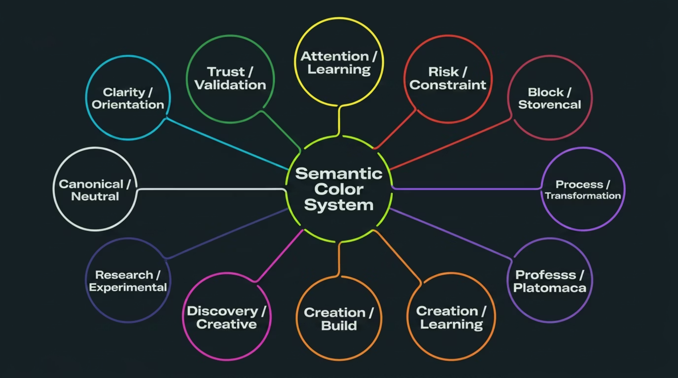

The Expansion Model: Color Families
Rather than adding individual colors, NIPC expands into color families — each family maps to a psychological function, enabling users to learn the system subconsciously. The architecture is: Color Family → Psychological Function → Semantic Roles → Token Variants.
Each family reinforces a subconscious expectation: cyan-ish things orient you, green-ish things signal trust, yellow marks what you must not miss. That depth of coherence is far more powerful than a flat list of 20 independent tokens.

Slide 6

FAMILY A
Clarity / Orientation Family
Use when the user needs to understand where they are, what something is, or how to read it. Blue and cyan feel calm, competent, and technical — lowering perceived risk and making dense interfaces feel navigable. This should be the dominant family across Aptlantis Studio.
info
structure
navigation
#22D3EE · General info panels, existing cyan default
#06B6D4 · Layout, architecture, schemas
#38BDF8 · Nav cards, related links, "where to go next"
reference
orientation
#7DD3FC · Canonical docs, definitions with links
#67E8F9 · Intro panels, "start here" blocks
Use heavily, but softly. Cyan is the system's ambient tone — it should feel like a background hum of clarity, not a shout.

Slide 7

FAMILY B
success · #34D399
Trust / Validation Family
Validated / good — existing green default
Use when the user needs to know this is usable, verified, safe, complete, or recommended. Green signals permission and safety — "you can proceed."
verified · #22C55E
Confirmed — dataset verification, checks passed
Reserve green for evidence-backed status only. If everything positive is green, it loses its meaning entirely.
stable · #86EFAC
Mature / safe — stable pipelines, production-ready
reproducible · #2DD4BF
Hashes, manifests, deterministic builds
available · #A7F3D0
Present / downloadable — download cards, mirror availability

Slide 8

Attention, Risk & Process Families
Three families govern the most cognitively loaded signals in the system — what to notice, what to stop for, and how the machinery works.
C · Attention / Learning
D · Risk / Constraint
E · Process / Transformation
Yellow family. Use as a marker, not a background. Left rail, badge, icon accent, or underline. Never fill a panel yellow — it causes fatigue and loses emphasis.
Red family. The strongest visual interrupt in the system. Red is sacred — it must mean something needs attention before proceeding. Never use red for ordinary emphasis.
Violet family. Abstract, conceptual, slightly futuristic. Means "this explains the machinery." Violet should never substitute for risk or trust signals.
important · #FACC15
note · #FDE047
caution · #FBBF24
decision · #F59E0B
memory-anchor · #FEF08A
process · #A78BFA
pipeline · #C084FC
transform · #D8B4FE
automation · #8B5CF6
orchestration · #DDD6FE
critical · #F43F5E
error · #EF4444
blocked · #FB7185
constraint · #E11D48
deprecated · #BE123C

Slide 9
FAMILIES F · G · H
Build, Discovery & Research Families
F · Creation / Build
G · Discovery / Creative
Orange family. Energetic, action-oriented — work is being done. Violet explains the pipeline; orange executes it. Use for code, CLI, generator output, and build steps.
Magenta family. Novel, expressive, emotional. Use sparingly so it retains the feeling of "this is special." Featured panels, homepage highlights, human-facing delight.
H · Research / Experimental
I · Canonical / Neutral
Indigo family. Thoughtful and exploratory — sits between trust-blue and abstraction-purple. Indigo does not mean "bad." It means "not fully settled yet."
White/Slate family. Neutral is the oxygen around the neon. Every bright semantic color needs nearby neutral restraint to preserve elegance and readability.

Slide 10
Recommended Intensity Scale
Hue carries semantic role. Intensity carries state. The two dimensions are independent — a pipeline can be conceptually "process/violet" while operationally in an "error" state. Keeping them separate is what distinguishes neon language from neon noise.
0 · Muted
1
Archived, unknown, background metadata — the quietest signal
2
1 · Whisper
Tiny dot, thin rail, subtle label — barely there but present
2 · Soft
3
Normal tags, semantic indicators — the everyday working register
4
3 · Active
Selected item, highlighted card — clearly chosen or in focus
4 · Urgent
5
Warning, running, featured — demands prompt attention
6
5 · Interrupt
Error, critical blocker only — the maximum signal reserved for true emergencies

Slide 11
Six Visual Rules
These rules are not preferences — they are the contract. Violating them degrades the cognitive signal of the entire system for every user who has learned to read it.
1
One dominant accent per artifact
Each card or panel gets one primary semantic color. Secondary colors appear only as tiny badges, icons, micro-rules, or metadata dots.
2
Red is sacred
Red must mean: error, critical, blocked, constraint, or deprecated. Do not use red just because it looks striking.
3
Yellow is a memory marker
Use yellow as a small, sharp marker — a left rail, badge, underline, or icon accent. Avoid yellow backgrounds entirely.
4
Green requires evidence
If something is merely positive but not verified, use cyan or magenta instead. Green demands evidence-backed status.
5
Magenta is the delight layer
Use it rarely enough that it genuinely feels special — featured, creative, spotlight, human note, discovery.
6
Neutral preserves elegance
For every bright semantic color, place nearby neutral restraint: dark panel, muted border, soft label, low-glow background.

Slide 12
Color Mapping for Q&A Pages
The Q&A page is where the color system can transform a wall of answers into a cognitive map. Each question type carries a distinct psychological direction that primes the reader before they even read the answer.
Question Type
Color Role
User Effect
What is this?
info / canonical
Calm understanding
Why does this matter?
important / memory-anchor
Increased retention
How does it work?
process / pipeline
Step-by-step thinking
What can I do with it?
operation / build
Action readiness
Is it trustworthy?
verified / reproducible
Confidence
What are the limits?
constraint / caution
Careful evaluation
What is experimental?
experimental / prototype
Proper expectation setting
What should I explore next?
discovery / navigation
Curiosity and movement

Slide 13
Artifact-Specific Recommendations
Color application must be scoped to artifact type. The same semantic role may render differently depending on the container — a qa-item uses a rail, a pipeline-panel uses a full background, and a dataset-card uses a header indicator.
qa-item
dataset-card
Small semantic rail or dot — never a full-color panel. Example: [03] | yellow rail | WHY LOCAL-FIRST MATTERS [+]
Color answers: what kind of dataset is this? Rust corpus → orange. Validated model → green. Experimental → indigo. Canonical schema → white.
pipeline-panel
theme-board
Main semantic color: violet (process). Overlay a small state marker for operational status: green pulse for success, yellow for warning, red for error.
Add a psychology row alongside swatches: Color → Role → Psychological Intent → Best Artifact Types. The theme-board is the canonical home for this documentation.

Slide 14

AIC Extended Theme Object
AIC should move beyond a flat semantic_role field to a richer semantic styling object. This gives generators, validators, and future agents the full context needed to make deterministic, drift-resistant rendering decisions.
Proposed Field Structure
Why Each Field Matters
semantic_role — tells the generator which color to apply
semantic_family — enables UI grouping and filtering
psychological_intent — documents why the color was chosen for future agents and validators
state + intensity + glow — keep rendering fully deterministic and prevent drift across artifact generations
{
"theme": {
"id": "neon-ink",
"semantic_role": "pipeline",
"semantic_family": "process",
"psychological_intent":
"explain-system-flow",
"state": "active",
"intensity": 2,
"glow": "soft",
"priority": "medium"
}
}
This aligns perfectly with AIC's core purpose: binding Neon Ink visual semantics to generated artifacts.

Slide 15
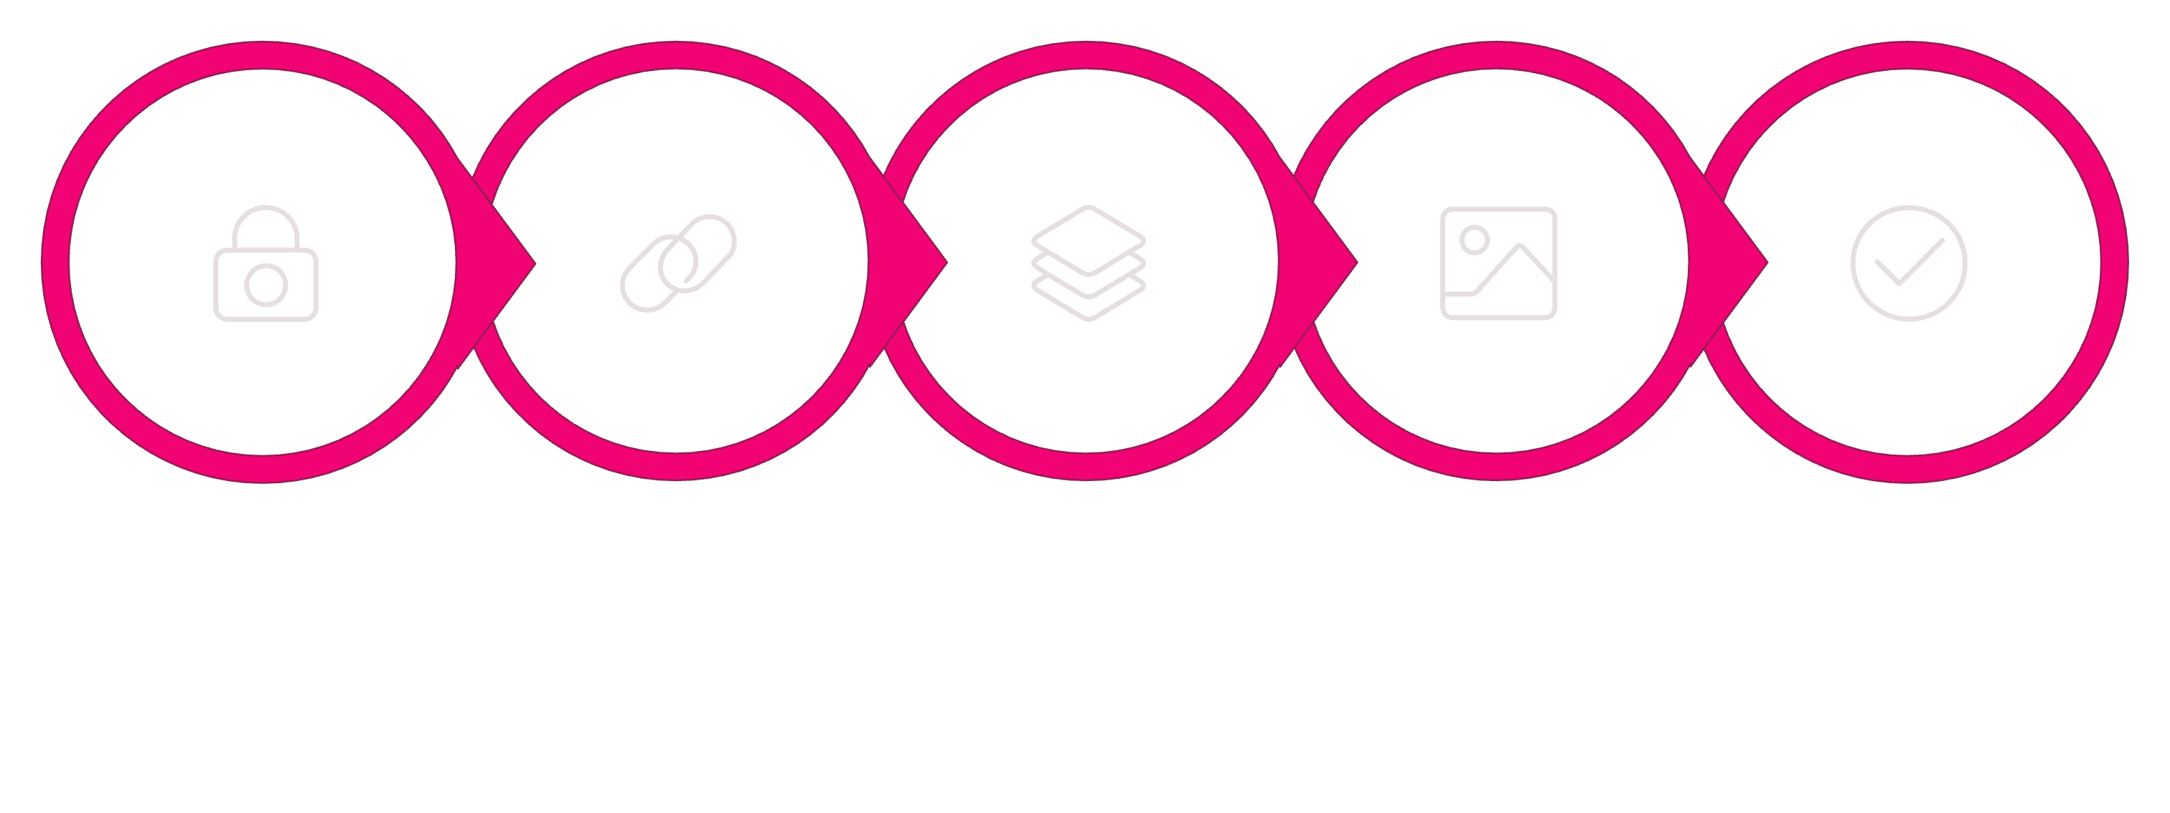
Implementation Roadmap
Roll out the expanded palette system in five disciplined phases. Resist the temptation to use all 45 tokens immediately — the system earns its complexity through staged adoption and validation.
Preserve
Alias
Extend
Visualize
Validate
Phase 1 — Preserve
Phases 2–3 — Expand Carefully
Phases 4–5 — Visualize & Validate
Keep the existing 9 core tokens exactly as-is. They are already correct and form the stable base everything else depends on.
Add aliases under families, then update SESM/AIC fields with semantic_family and psychological_intent. Do not use all tokens everywhere immediately.
Build the theme-board SVG and add generator validation warnings. Red with non-risk roles, yellow at intensity > 3, or missing semantic indicators on qa-item should all trigger warnings.

Slide 16

The System in Full
Forty-five tokens. Nine families. One governing principle. The NIPC is not a style guide — it is a palette contract. Its power comes not from the richness of individual colors, but from the coherence of the system as a whole.
9
Color Families
Each maps to a distinct psychological function
45
Semantic Tokens
Grouped, not chaotic — families prevent drift
6
Visual Rules
Binding constraints that protect the system's signal integrity
5
Rollout Phases
Staged adoption that preserves stability while expanding expressiveness
Neutral is not boring. Neutral is the oxygen around the neon. And the user should eventually learn the system without being taught — that is the sweet spot: visually rich, emotionally pleasant, and cognitively useful.

