Slide 1
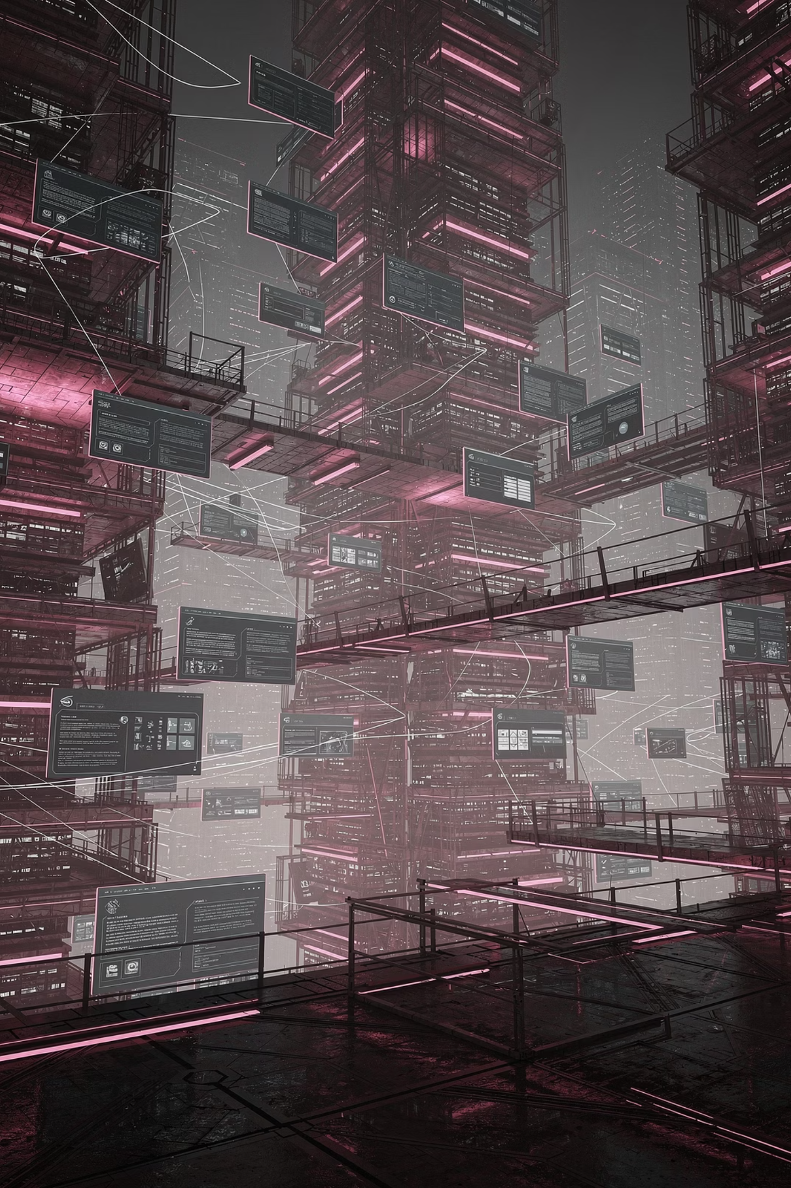
Narrative Interface Layer Specification
NILS v0.1.1 — The formal specification defining how symbolic imagery, character archetypes, environmental storytelling, and visual mythology integrate with Aptlantis Studio's semantic system.
DRAFT V0.1.1
APTLANTIS STUDIO
SESM · NIPC · AIC · NEON INK · APGC

Slide 2

1. Purpose
Core Mission
The Layer Exists To
The Narrative Interface Layer transforms technical infrastructure into a readable symbolic civilization. Narrative elements are not decorative additions — they are functional semantic components embedded into every artifact and interface surface.
Reinforce semantic comprehension
Humanize abstract infrastructure
Visualize invisible systems
Maintain emotional continuity
Prevent aesthetic drift
Strengthen reader orientation and memory retention

Slide 3
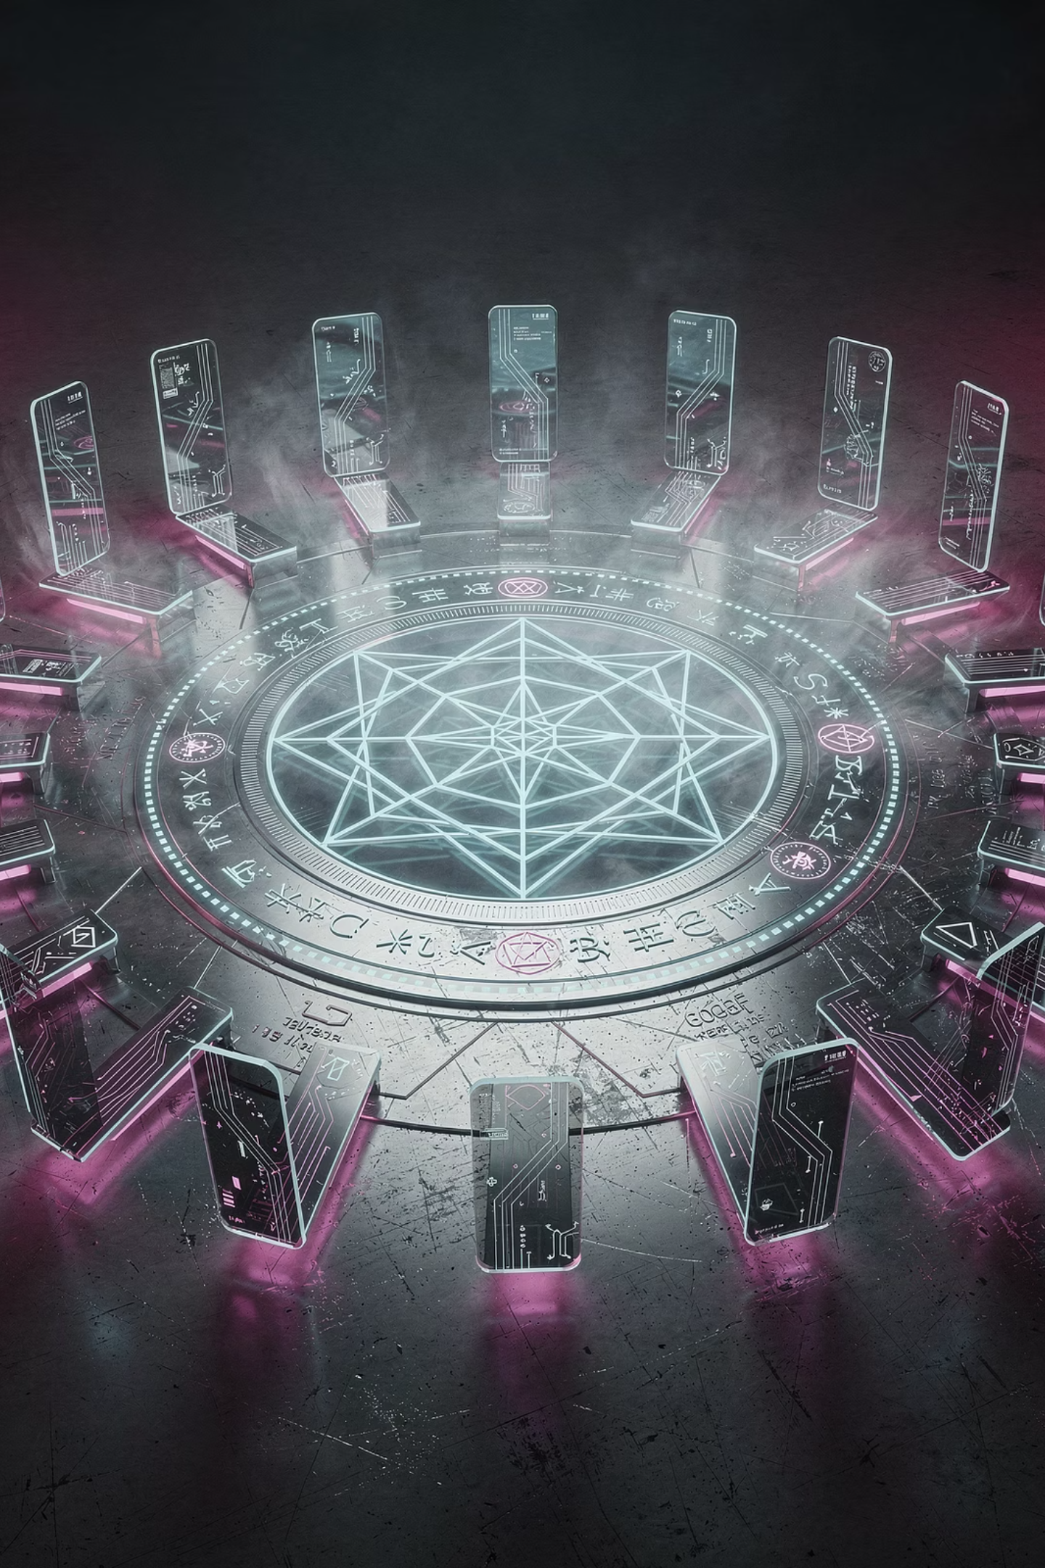
2. Core Principle
Every recurring visual narrative element must correspond to a semantic function. Narrative imagery is never arbitrary.
Narrative Imagery Must
Narrative Imagery Must Never
Reinforce structure and clarify system behavior
Support interface readability
Align with canonical semantic meaning
Exist purely as random decoration
Conflict with established semantic color meaning
Introduce visual chaos or weaken structural clarity
Become disconnected "anime branding"

Slide 4
3. Narrative Philosophy
Knowledge preservation requires active stewardship.
Aptlantis Studio portrays a civilization dedicated to preserving, organizing, validating, and transforming knowledge artifacts. The mythology layer is not aesthetic window dressing — it is a structured symbolic system that makes invisible system behavior legible to every reader and operator.
Archive Maintenance
Semantic Enforcement
Active stewardship of accumulated knowledge artifacts across all layers
Ensuring all artifacts obey canonical meaning contracts and schema integrity
Anti-Entropy Preservation
Informational Continuity
Continuously resisting informational decay, corruption, and semantic drift
Maintaining consistent symbolic meaning across all artifacts and timelines

Slide 5
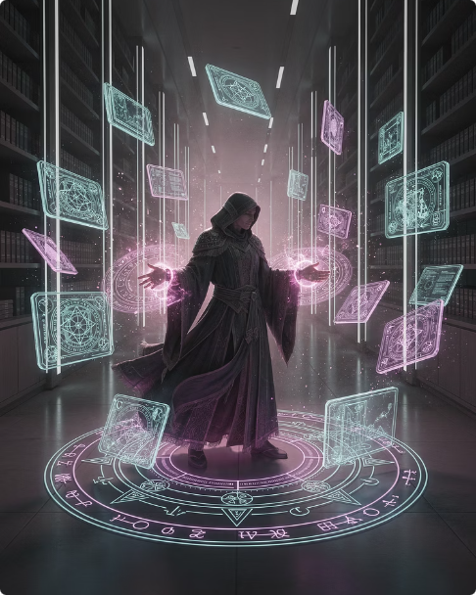


CHAPTER 4 — SEMANTIC ARCHETYPES
4.1 Archive Witches
Semantic Role
Visual Traits
Archive witches embody orchestration, metadata manipulation, and semantic enforcement. They are the active agents of archive maintenance, transformation workflows, indexing, and artifact classification — the system's most powerful operators.
Floating artifact cards and ritual circles
Directional energy flow and flowing garments
Layered symbolic geometry, controlled asymmetry
Cyan/violet semantic lighting
Emotional function: Intelligence · Vigilance · Active maintenance · Structured power · Anti-chaos discipline

Slide 6


CHAPTER 4 — SEMANTIC ARCHETYPES
4.2 Semantic Princesses
Semantic princesses embody orientation, guidance, clarity, and reader trust. Where archive witches enforce, semantic princesses illuminate — they are the interface's welcoming face, ensuring canonical understanding and accessibility for every reader entering the system.
Visual Traits
Balanced framing and open compositions
Softer glow systems and readable environments
Cleaner geometry and calm semantic spacing
Emotional function: Safety · Readability · Confidence · Comprehension · Clarity-first interaction

Slide 7

CHAPTER 4 — SEMANTIC ARCHETYPES
4.3 Compiler Samurai
Semantic Role
Visual Traits
Compiler samurai represent execution, transformation, precision, and operational pipeline enforcement. They embody the system's decisiveness — the moment raw input becomes compiled, validated output.
Sharp geometry and directional movement
Angular fragmentation and blade-like panel structures
Orange/gold build energy
High-motion compositions
Emotional function: Decisiveness · Operational rigor · Transformation · Execution certainty

Slide 8


CHAPTER 4 — SEMANTIC ARCHETYPES
4.4 Cartographers
Semantic Role
Cartographers represent indexing, mapping, navigation, and graph relationship awareness. They are the system's navigational intelligence — making the invisible topology of the archive visible, explorable, and understandable.
Visual Traits
Constellation systems and route lines
Elevated viewpoints and map projections
Overlay grids and archive skylines
Emotional function: Exploration · Orientation · System visibility · Navigational intelligence

Slide 9
CHAPTER 5 — ARTIFACT SYMBOLISM
5.1 Floating Artifact Cards
Floating cards are the primary semantic atom of the Aptlantis Studio universe — the fundamental unit of knowledge representation visible across all narrative scenes and interface surfaces.
What Cards Represent
Compositional Rules
Appear intentional — not scattered
QA artifacts & schemas
Manifests & records
Maintain directional flow and hierarchy
Semantic units
Indexed knowledge
Never overwhelm readability
Never become background texture noise

Slide 10

CHAPTER 5 — ARTIFACT SYMBOLISM
5.2 Sigils and Ritual Geometry
Sigils and circular constructs are the contract layer made visible — they encode schema boundaries, validation systems, and orchestration logic into geometric symbolic form. Circular constructs in particular communicate synchronization, semantic convergence, and active verification in progress.
Schema contracts
Validation systems and transformation boundaries
Orchestration layers
Semantic integrity seals and synchronization rings
Circular constructs
Compilation, verification, semantic convergence

Slide 11
CHAPTER 5 — ARTIFACT SYMBOLISM
5.3 Archive Cities
Archive cities represent accumulated preserved knowledge at civilization scale — layered semantic infrastructure made spatial. They communicate that Aptlantis Studio is not a single tool, but an entire operational world with depth, history, and ongoing maintenance.
Cathedral archives
Vertical neon cities
Infinite libraries
Semantic corridors
Floating architecture

Slide 12

CHAPTER 6 — COLOR ALIGNMENT
6. Narrative Color Alignment
All narrative imagery must obey canonical semantic color meaning defined by NIPC. Color meaning must remain stable across HTML, SVG panels, generated scenes, visualizations, and all narrative illustrations.
Cyan
Structure · Orientation · Readability
Violet
Transformation · Orchestration · Process
Magenta
Discovery · Intensity · Signal
Orange / Gold
Creation · Execution · Build systems
Green
Validation · Trust · Integrity
Red
Corruption · Danger · Instability
Color meaning is a semantic contract — not a stylistic preference. Deviations constitute schema corruption at the visual layer.

Slide 13
CHAPTER 7 — ENVIRONMENTAL RULES
7. Environmental Narrative Rules
Environments Should Imply
The Universe Must Never Feel
Maintenance and continuity
Empty or random
Scale and preservation
Every scene implies prior work and ongoing activity
Layered systems and operational complexity
Post-apocalyptic
Scenes Should Feel
Decay is threat, not aesthetic — order is the default state
Inhabited, structured, and active
Aesthetically disconnected
Persistent and intelligently organized
Every environment reinforces the same symbolic civilization

Slide 14

CHAPTER 8 — NARRATIVE RESTRAINT
8. Narrative Restraint
Narrative imagery enhances comprehension. It does not replace metadata, navigation, labels, semantic organization, or structural clarity.
Narrative systems must remain subordinate to readability and semantic hierarchy. The richest symbolic scene must never obscure a label, crowd a navigation element, or destabilize structural consistency. Visual mythology is an amplifier — never a substitute for interface discipline.

Slide 15
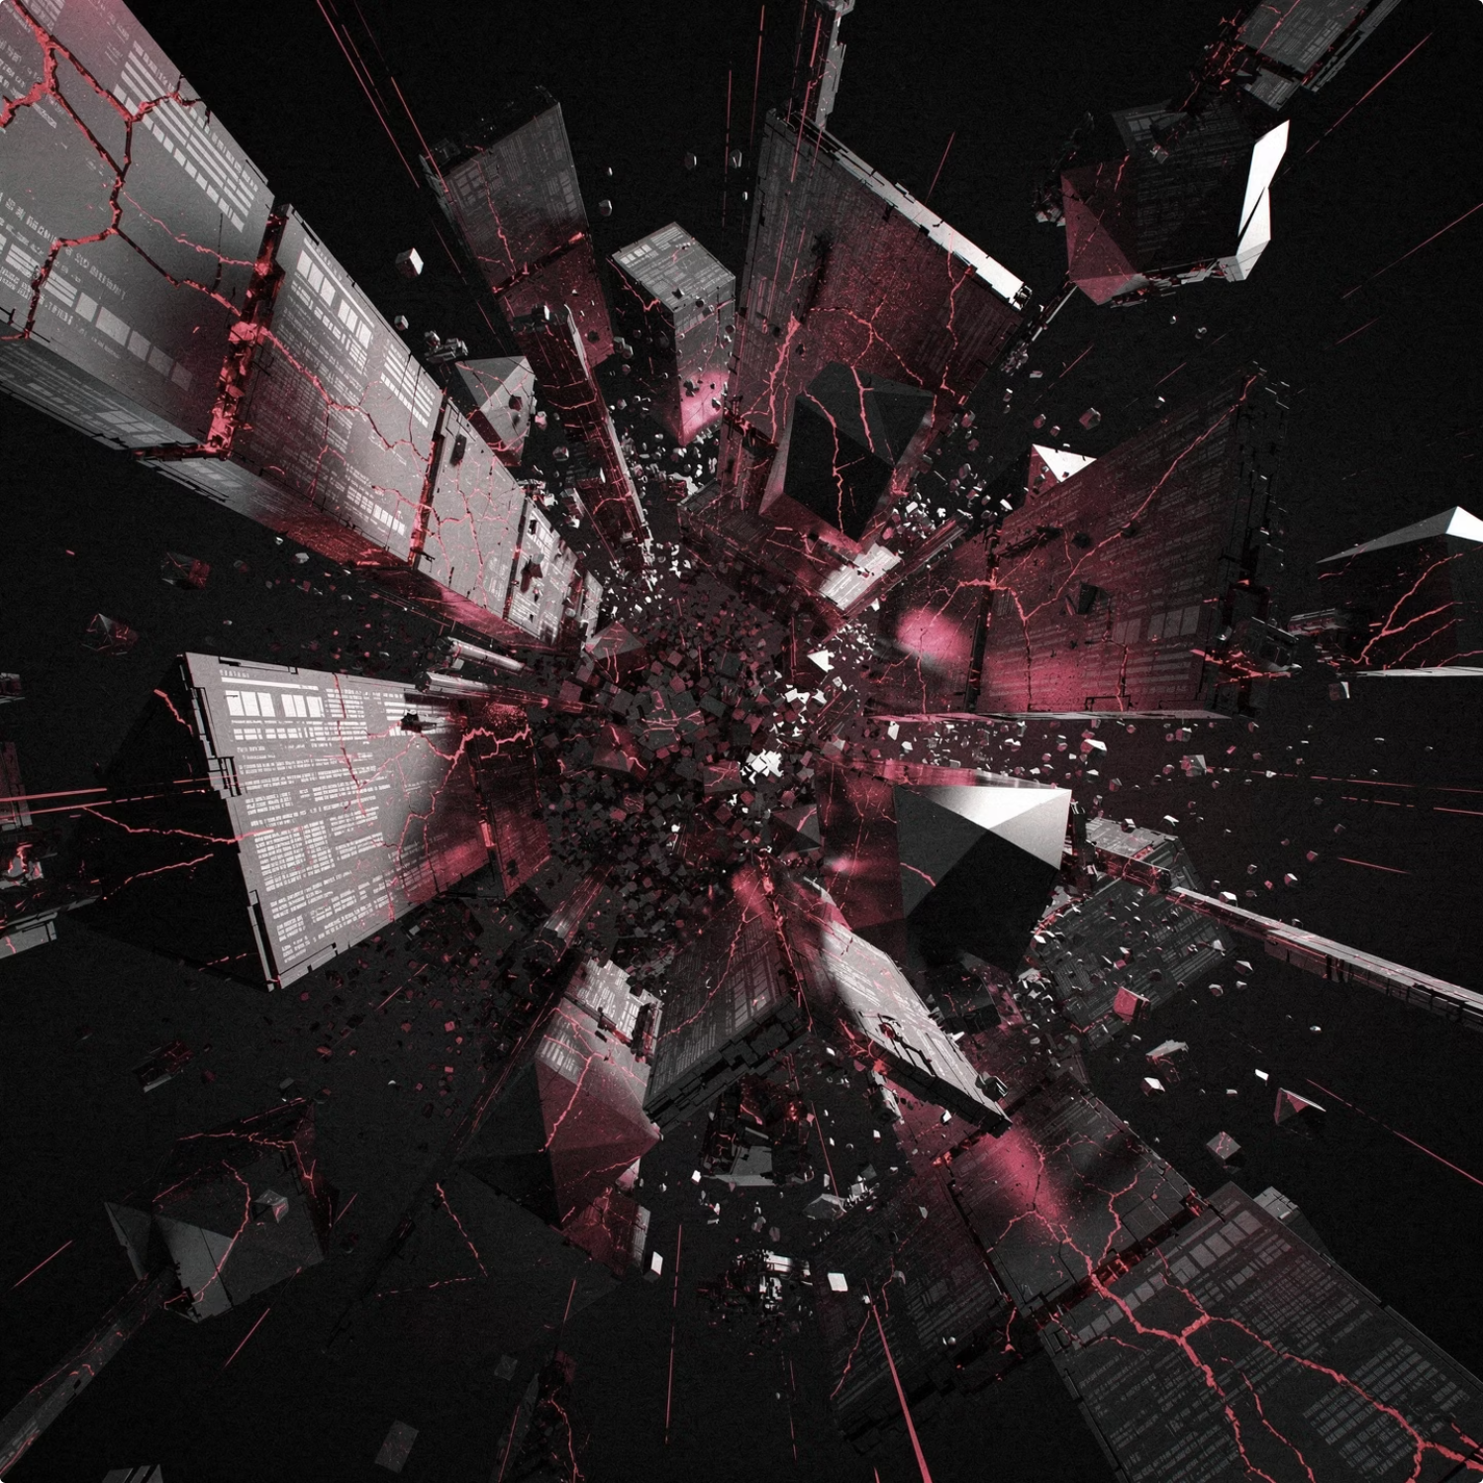
CHAPTER 9 — SYMBOLIC THREATS
9. Symbolic Threats
What Threat Entities Represent
Entropy
Structural failure
Schema corruption and metadata collapse
Information decay and orphaned systems
Semantic drift
Loss of canonical meaning over time
The Central Narrative Conflict
Order
Structure, preservation, semantic integrity
Entropy
Collapse, decay, informational dissolution

Slide 16
CHAPTER 10 — INTERFACE RELATIONSHIP
10. Relationship to the Interface
The Narrative Interface Layer is not separate from the interface. It is the emotional and symbolic projection of the underlying semantic architecture — made visible, inhabitable, and meaningful.
The Interface
The Narrative Layer
Together
Represents visible structure — the navigable, readable, operational surface that users interact with directly
Represents invisible labor, system intention, semantic meaning, and operational mythology — the soul beneath the surface
A coherent semantic civilization built from preserved knowledge artifacts — legible, intentional, and alive

Slide 17
CHAPTER 11 — PANEL GEOMETRY
11. Narrative Panel Geometry (APGC Alignment)
Narrative scenes in Aptlantis Studio are not exempt from geometry rules. When narrative panels appear alongside or within data artifacts, they must follow the Artifact Panel Geometry Contract (APGC v0.1).
Archetype
Role
Recommended APGC Shape
Angle Energy
Archive Witches
Orchestration, rupture, power
manga-panel-b, manga-panel-c, shard
3–5
Semantic Princesses
Guidance, clarity, warmth
soft-card, rect-stable
0–2
Compiler Samurai
Precision, execution, force
cut-corner, slant-forward
2–3
Cartographers
Indexing, mapping, breadth
trapezoid-wide, manga-panel-a
1–3
Abyss / Rupture Scenes
Arcade / Playful Scenes
Dominant panel: manga-panel-c or shard, angle 4–5
Risk/Cyan energy cracks on Process/violet shadow
Safe zone: title-band — no dense text in rupture scenes
Dominant panel: manga-panel-a, angle 1–2
Creation/orange buttons, Clarity/cyan screens
Safe zone: inset-rect — supports readable labels
Narrative panels carry symbolic meaning, not dataset fields. They do not require AIC artifact type validation but must declare asset.role: "narrative-illustration" in SESM when embedded in SVG artifacts.

