Slide 1

Neon Ink v0.1
The governing visual and semantic design standard for Aptlantis Studio — unifying website UI, generated SVG artifacts, SESM metadata, Tailwind/CSS tokens, Canva assets, presentations, and all future brand surfaces into one durable, artifact-driven system.
DRAFT V0.1
WHOLE-BRAND STANDARD
APTLANTIS STUDIO

Slide 2

What Neon Ink Governs
Neon Ink is not only a color palette. It is an artifact-driven interface standard — defining how the Studio looks, reads, behaves, and describes itself across every brand surface.
Static Pages
Generated Artifacts
Website, dataset detail, pipeline, about, and documentation pages.
Compiled SVG panels, SESM metadata blocks, dataset and pipeline cards.
Brand Collateral
Theme Boards
Canva templates, slide decks, social graphics, and promotional surfaces.
Semantic mapping demos, variant specs, and future named subthemes.
Core Rule: Visuals are derived from the data. The website, SVGs, cards, and marketing surfaces should feel like parts of the same durable archive — static enough to last, structured enough to regenerate, expressive enough to make datasets worth exploring.

Slide 3
Design Philosophy
Signal Over Scale
Local-First Durability
Aptlantis Studio exists for high-signal datasets, focused pipelines, and small specialist models. The interface must prioritize recognition, status, provenance, and reproducibility over decorative novelty.
Studio artifacts should remain meaningful when copied, mirrored, archived, screenshotted, or viewed outside the original website. Generated SVGs carry semantic context through SESM.
Panels As Artifacts
Welcoming Technicality
The default component model is an artifact panel — not a generic dashboard card. Borders signal artifact type; glows signal state; badges carry short role or class identifiers.
Precise, inventive, durable, and builder-friendly. The voice avoids corporate AI hype and vague claims. Technical without becoming hostile or obscure.

Slide 4
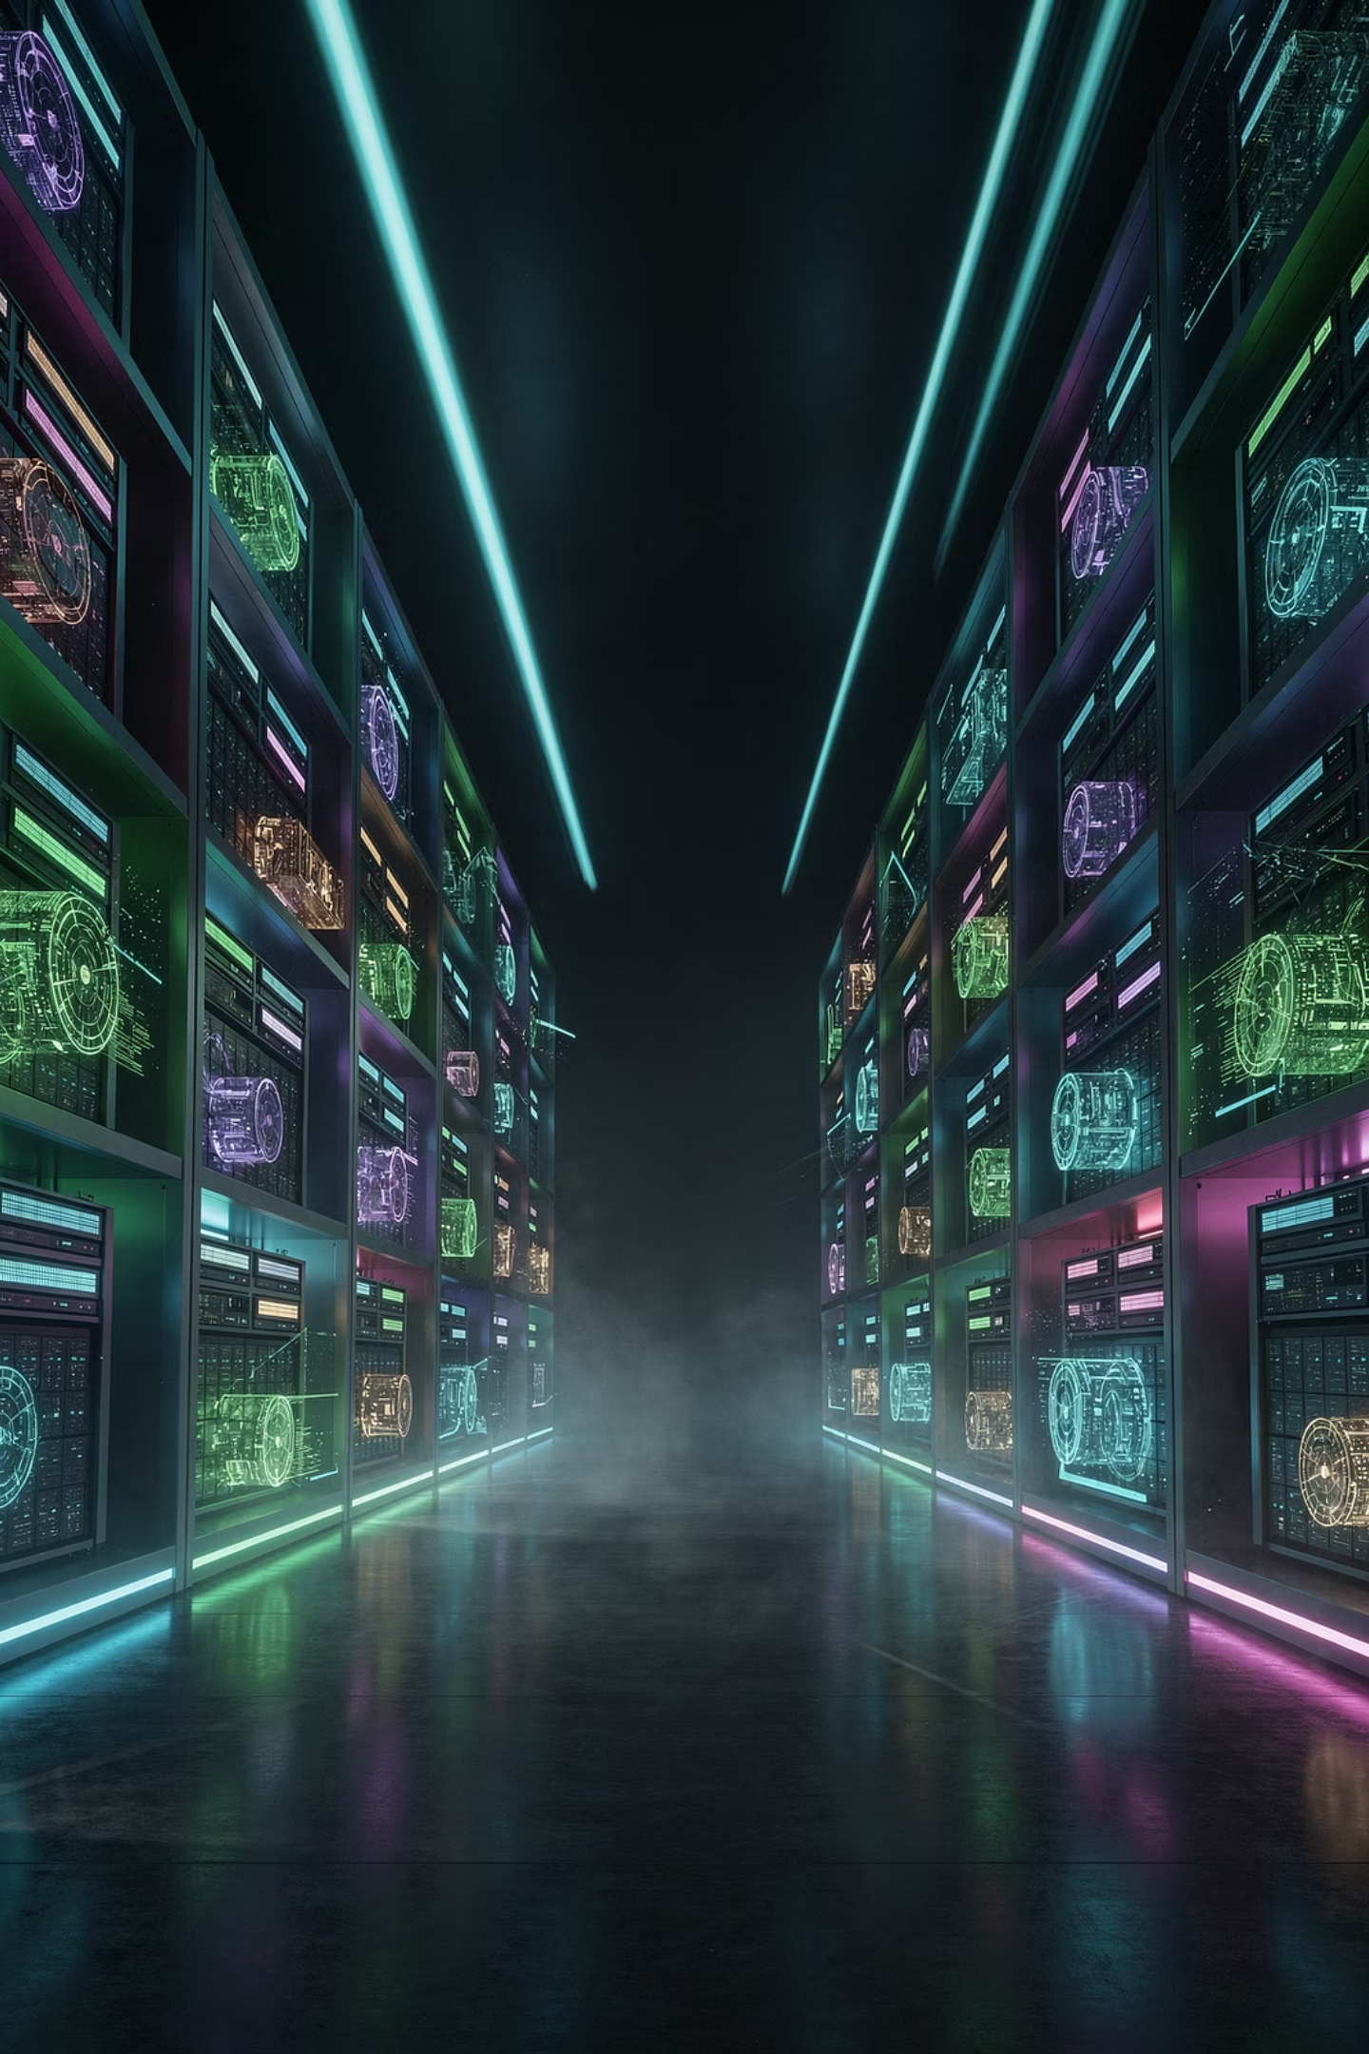

Brand Foundation
Studio Position
Brand Personality
Aptlantis Studio creates and publishes unique, niche, practical, and creative datasets for fine-tuning small local models. It is not a massive scrape marketplace — it is a focused workshop for reproducible, human-sized model building.
Inventive
Experimental and future-facing in every artifact.
Durable
Archive-aware, reproducible, and local-first by design.
Primary Audiences
Hobbyist model builders and local AI experimenters
Dataset curators, archivists, and researchers
Creative tool makers and developers building small specialist models
Welcoming
Builder-friendly, never corporate or dismissive.
Precise
Clear about data, schemas, licenses, and build state.

Slide 5
CORE PHRASES
Build small.
Train local.
Create worlds.
Unique datasets. Real worlds.
Local power.
High-signal datasets for small specialist models.
Compiled artifacts for reproducible local training.

Slide 6

Background Layer System
The background system creates depth through value shifts, not heavy chrome. Five tokens form a perceptual stack from the deepest environment to raised interactive surfaces.
Token
Hex
Role
--studio-void
#050816
Deep baseline canvas — outermost environment
--studio-base
#0B0F1A
Page baseline and primary surface
--studio-panel
#111827
Artifact container surface
--studio-raised
#162033
Raised or emphasized panel layer
--studio-soft
#0F172A
Soft secondary panel layer
Use Void as the outermost environment. Use Base for main page regions. Use Panel for artifact containers. Never invert this hierarchy — depth should always read from darkest outward to slightly lighter inner surfaces.

Slide 7
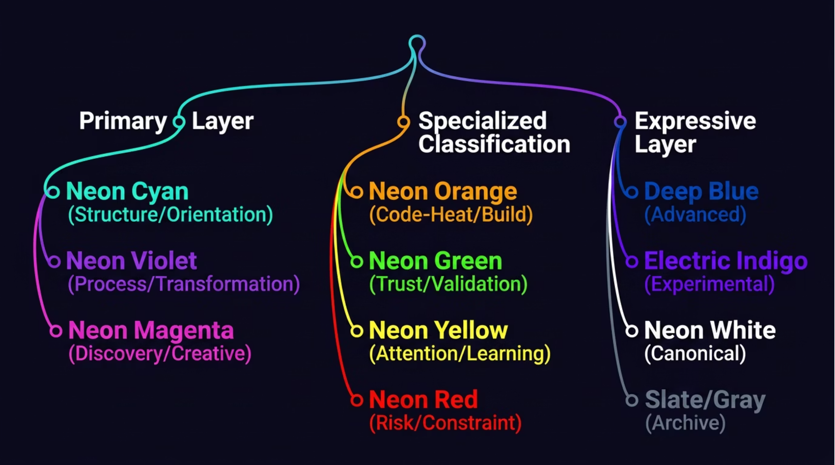

Semantic Color Taxonomy
NIPC is the canonical palette layer for Neon Ink. Color should reduce cognitive load before it adds beauty. Every hue carries a semantic family and psychological intent.
Each color family carries a psychological intent — the reason a semantic role was chosen, written for future generators, validators, and agents. Use this taxonomy to assign meaning, not decoration.

Slide 8
Core Stable Color Tokens
These eight tokens form the stable base that NIPC expands into families. New work should always use these NIPC v0.1 tokens; legacy aliases are permitted only for existing generated SVG preservation.
Token
Hex
NIPC Family
Primary Use
info
#22D3EE
Clarity / Orientation
General info, calm understanding, structure labels
process
#A78BFA
Process / Transformation
Pipelines, how-it-works, system flow
featured
#F472B6
Discovery / Creative
Featured, creative, and spotlight content
success
#34D399
Trust / Validation
Validated, good, evidence-backed pass signals
important
#FACC15
Attention / Learning
Caveats, notes, memory anchors
critical
#F43F5E
Risk / Constraint
Risk, blockers, failure, urgency
code-heat
#F97316
Creation / Build / Code
Rust, build, execution, artifact output
experimental
#818CF8
Research / Experimental
Prototype, research, unsettled work

Slide 9
Dataset Accent Language
Dataset accents describe subject matter, not global state. Each domain maps to a semantic token chosen for cognitive fit, not arbitrary decoration.
Rust / Code Heat
RPG / Dungeon Synth
code-heat #F97316
process / creative
Rust corpora, compiler material, crate metadata, and build pipeline artifacts.
Tabletop lore, NPC dialogue, item lists, spells, and world-building datasets.
Creative / Discovery
Verified / Complete
featured #F472B6
success #34D399
Generative writing, worldbuilding, and featured creative dataset releases.
Release-ready artifacts, license pass, and quality-validated datasets.
Review / Warning
Error / Failed
important #FACC15
critical #F43F5E
Partial validation, caveats, and items requiring manual review.
Broken builds, failed validation, and hard blockers preventing release.

Slide 10
Typography System
Three-Role Hierarchy
Every typographic decision in Neon Ink maps to one of three roles: Display, System Mono, or Body Copy. Each role has a distinct cognitive job.
Display
Heavy, condensed, optionally italic. Used for hero headlines, campaign phrases, large theme labels, and high-energy section headers. Never for dense metadata or long paragraphs.
Recommended Stacks
Display: Rajdhani, Orbitron, system-ui
Mono: JetBrains Mono, Cascadia Code
Body: Plain readable sans-serif
System Mono
The technical backbone. Used for dataset IDs, version numbers, pipeline names, build status, commands, metadata rows, and manifest references.
Body Copy
Plain, readable, and direct. Let panels, semantic color, and SVG artifacts carry the visual intensity. Body copy provides clarity, not decoration.

Slide 11
Panel State System
Every artifact panel has a single dominant state, communicated through border color, glow intensity, and badge label. Secondary semantic colors appear only as small badges, icons, or metadata dots.
State
Visual Behavior
Semantic Meaning
idle
Dim border, no glow
Dormant, quiet, or default artifact
active
Soft cyan glow
Current, selected, browsed, or ready
running
Pulsing violet glow
Pipeline or transformation in progress
featured
Magenta glow
Notable, new, creative, or highlighted
verified
Green status signal
Quality or license validated
warning
Yellow accent / glow
Needs review or carries a caveat
error
Red accent / glow
Failed, blocked, or invalid
archived
Slate/gray muted styling
Dormant, mirrored, or historical

Slide 12
Component Grammar
Every component in Neon Ink has a defined semantic role. Panels, badges, tags, and links each carry meaning through consistent color and form.
Artifact Panels
Badges
Expose title, artifact type, state badge, semantic accent, brief description, key metadata, and a canonical action or destination.
Short, uppercase, state-driven. Colored by semantic meaning and readable at small sizes. Examples: ACTIVE, RUNNING, VERIFIED, RUST.
Tags
Links & Actions
Identify subject matter or semantic category. Rust → orange. Process → violet. Info → cyan. Featured → magenta. Warning → yellow. Error → red.
Navigation → cyan. Process/action → violet. Discovery → magenta. Download → green. Dangerous → red. Color encodes intent before the user reads the label.

Slide 13
Dataset Card Anatomy
Dataset cards are the most important artifact pages. They must support quick scanning before reading — every trust signal should be visible at a glance.
Required Metadata Fields
Example Metadata Shape
Dataset identity header with semantic tags and state badge
Quality or validation signal when available
Core stats: records, tokens, size, license, created/updated
Download or canonical action
Samples, structure, pipelines, versions, changelog navigation
Latest pipeline run and compatibility signals
Visible provenance or metadata where trust matters
{
"id": "rust-code-corpus",
"title": "Rust Code Corpus",
"state": "active",
"domain": "rust",
"tags": ["rust","code","training"],
"records": 532104,
"tokens": "18.7B",
"size": "7.2 GB",
"license": "MIT",
"quality_score": 96,
"created": "2025-04-12",
"updated": "2025-05-18"
}

Slide 14

Pipeline Page Requirements
Pipeline pages must make process state visible at every stage. Use violet for process and running states; green, yellow, and red for validation outcomes.
Collect
Validate
Normalize
Each pipeline card should expose the pipeline ID, associated dataset, current state, stage list with completion timestamps, record and token changes, warning and error counts, and a link to logs, reports, or the canonical pipeline manifest.
Running
Complete
Warning
Error
Violet glow — transformation in progress.
Green emitter — all stages passed.
Yellow accent — caveat or review needed.
Red accent — failed, blocked, invalid.

Slide 15



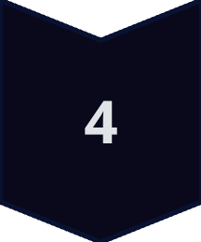


SVG + SESM Requirements
Neon Ink uses SESM v0.2.0 as its embedded semantic metadata carrier for SVG artifacts. Generated Aptlantis Studio artifacts treat three documents as a layered system.
DATA
Source records, manifests, and pipeline output
SESM
Embedded metadata, identity, provenance, agent hints
AIC
Artifact types, required fields, layout, render targets
SVG / HTML
Brand expression, typography, panel grammar
USER
Scannable, trustworthy, self-describing artifact
Only sesm_version is required by SESM, but Aptlantis Studio production artifacts should include enough metadata — asset, artifact, theme, ui, crawl, provenance, integrity — to remain self-describing when detached from the website.

Slide 16
SESM Neon Ink Theme Block
Every compiled SVG artifact should declare its theme identity. The recommended Neon Ink SESM theme block provides palette semantics, state intensity, glow level, and the full token set for downstream validators and generators.
Required Top-Level SESM Fields
{
"theme": {
"id": "neon-ink",
"name": "Neon Ink",
"version": "0.1.0",
"mode": "dark",
"accent": {
"name": "orange",
"hex": "#F97316",
"semantic_role": "code-heat",
"psychological_intent":
"signal-hands-on-code-build-work"
},
"state": {
"name": "active",
"intensity": 2,
"glow": "soft"
}
}
}
01
asset
File identity, format, and dimensions
02
artifact
Type, state, semantic role, and category
03
theme
Neon Ink theme ID, NIPC tokens, intensity
04
provenance
Generator, build ID, source records, template
05
links
Canonical HTML, manifest, and related resources

Slide 17
Page Composition Rules
Pages should feel like navigable archives, not generic SaaS dashboards. Composition decisions should reinforce the artifact-first identity of the Studio at every viewport.
✓ Use
✗ Avoid
Dark layered backgrounds following the token stack
Dense but organized metadata with visible roles and states
Semantic color used for meaning, not random decoration
Enough negative space to prevent visual noise
Artifact panels with provenance visible where trust matters
Glow reserved for active state and live activity signals
Generic blue SaaS gradients and decorative hero surfaces
Cards with no semantic role or state identity
Hiding provenance, status, or dataset identity
Overusing glow on static or non-interactive content
Burying dataset identity below generic navigation chrome
Making every page a marketing hero instead of an archive entry point

Slide 18
Content & Voice Rules
Preferred Language
Avoid
High-signal datasets, small specialist models
AI magic, one-click intelligence
Local-first training, reproducible pipelines
Massive scraped everything
Compiled artifacts, curated niche corpora
Corporate productivity platform language
Dataset recipes, manifests, archive-ready releases
Generic chatbot branding or cloud-only framing
Practical licensing, local machines
Vague claims of intelligence without evaluation context
Aptlantis Studio publishes focused datasets for builders who want useful small models on personal hardware. Every release favors clear manifests, durable formats, practical licensing, and reproducible pipelines over noisy scale.

Slide 19
Validation Checklist
Use this checklist before treating any page, SVG, template, or brand asset as Neon Ink v0.1 compliant.
Color
SESM
Uses NIPC v0.1 tokens for all new work
Compiled SVGs include SESM v0.2.0 metadata
Legacy aliases only for existing SVG preservation
theme.id is neon-ink
Records semantic_role, family, psychological_intent, intensity
Semantic role and family names match NIPC
One dominant accent per artifact panel
State names match this spec
Red/risk only for blockers, failures, hard constraints
Generated artifacts include provenance when available
Green/trust only when validation evidence exists
Brand
Layout
Voice is precise, inventive, durable, and welcoming
Page reads as a navigable archive
Copy favors high-signal data and local-first training
Artifact identity appears early in the viewport
Marketing surfaces use the same color meanings as website
Metadata visible where trust matters
No generic AI magic or cloud-only positioning
Glow used for state/activity, not everywhere

Slide 20

The North Star
An archive that is alive.
Static enough to last. Structured enough to regenerate. Expressive enough to make datasets feel like artifacts worth exploring.
Dark Archival Backgrounds
Five-layer token stack from void to raised surface.
Semantic Neon Color
NIPC families with psychological intent, not decoration.
Panel-Based Composition
Artifact panels as the default component model.
Visible Provenance
SESM-compatible SVGs with self-describing metadata.
NEON INK V0.1
APTLANTIS STUDIO
DRAFT — CANONICAL FROM V0.1 FORWARD

