Slide 1

SVG Embedded Semantic Metadata (SESM)
A standard for embedding structured metadata and instructions directly inside SVG files — turning visual assets into self-describing, machine-readable artifacts.
DRAFT V0.2
ASSET-LEVEL METADATA
APTLANTIS STUDIO

Slide 2

What Is SESM?
The Core Idea
SVGs as Multi-Role Artifacts
SESM defines a simple, implementation-agnostic way to embed structured metadata inside SVG assets. SVGs become more than images — they carry semantic context wherever they go.
Visual assets and metadata carriers
Semantic capsules and archive-friendly documentation
LLM-readable context packets
UI runtime hints
Generated artifacts with provenance

Slide 3
Why SESM Matters for Aptlantis Studio
In Aptlantis Studio, many visible interface components are compiled SVG artifacts generated from JSON or JSONL manifests. A single SVG can represent a dataset card, pipeline status panel, theme board, stats panel, navigation artifact, dataset identity badge, or a crawler-facing semantic summary.
Dataset Card
Pipeline Panel
Structured identity for curated datasets
Status and provenance for build pipelines
Theme Board
Crawler Summary
Visual system palette and semantic roles
Indexing hints embedded in the asset itself

Slide 4
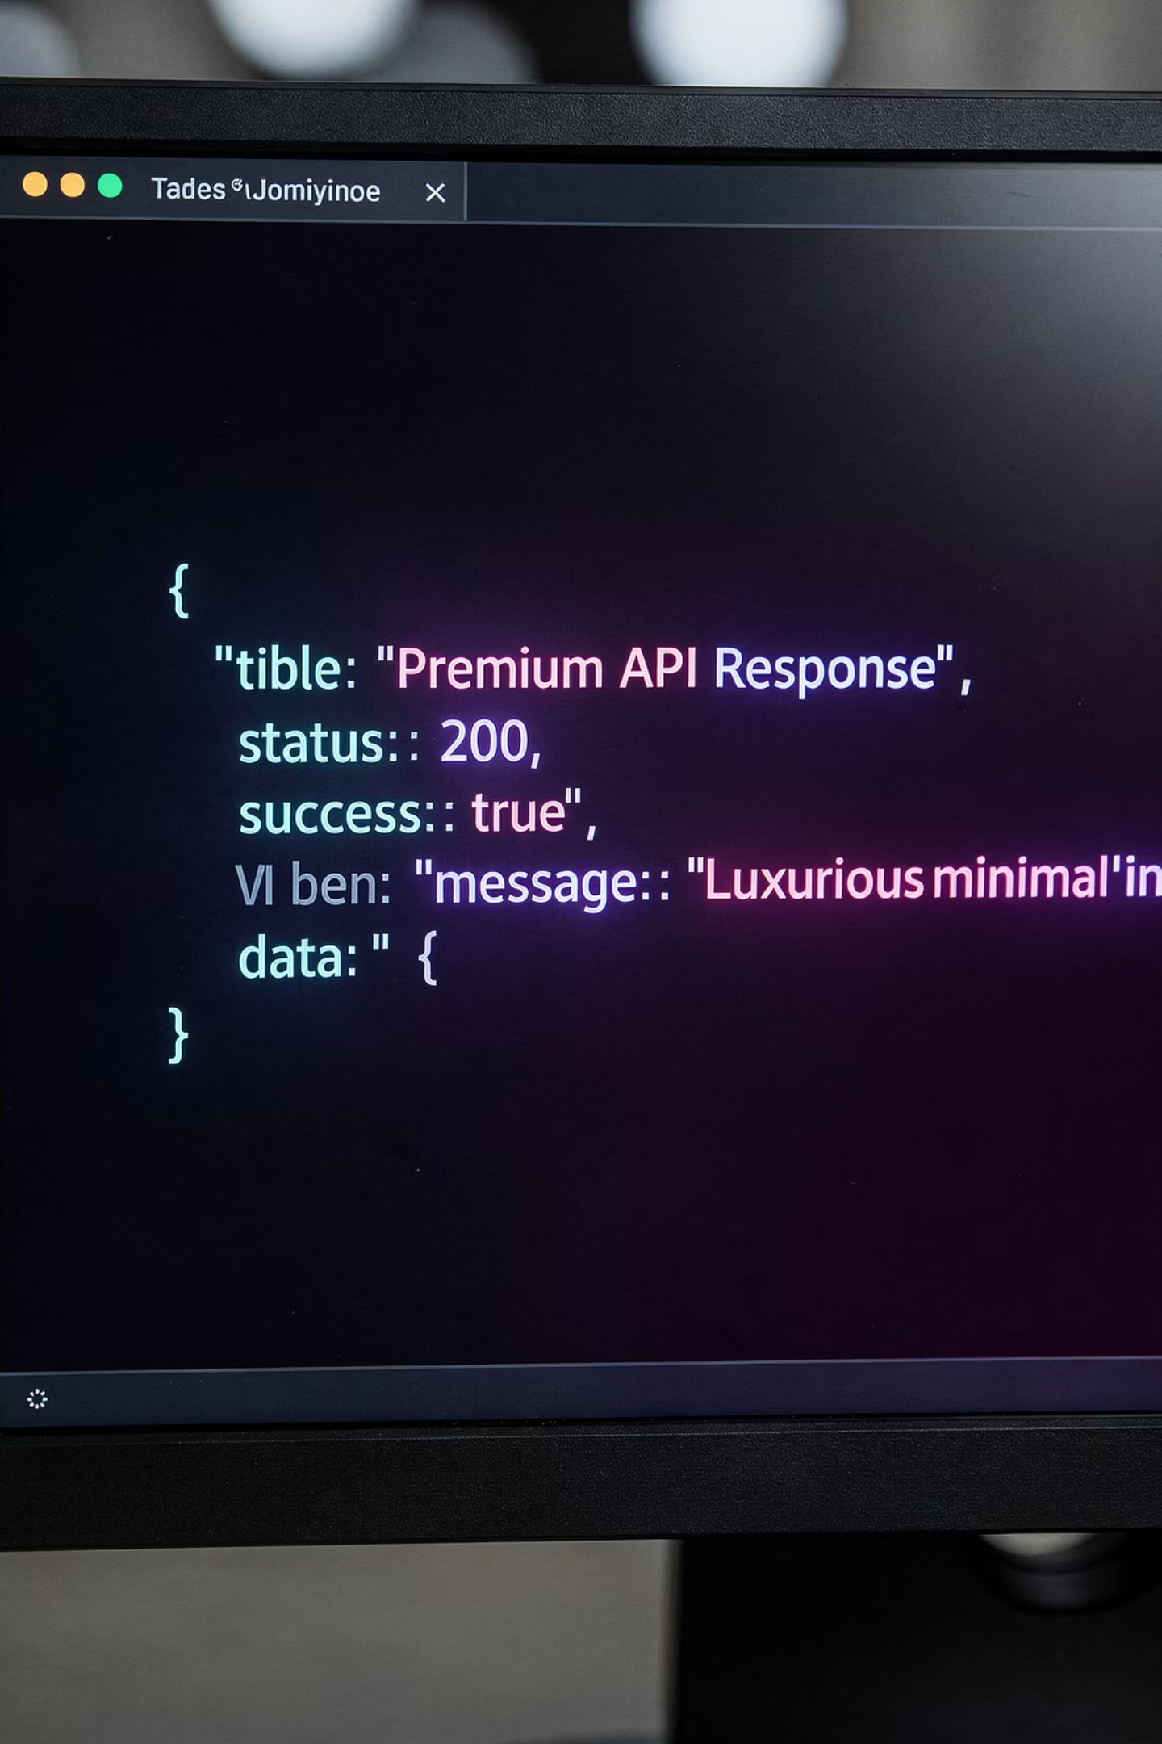
Design Philosophy
Put a valid JSON object inside an SVG <metadata> element. Everything else is convention.
SESM is intentionally simple. This simplicity is what allows it to survive static hosting, mirroring, scraping, archival, direct filesystem copying, Internet Archive uploads, local agent indexing, page extraction, and build pipeline regeneration.
SESM should be easy to generate from a small Rust, Go, Python, or JavaScript utility — no heavy framework required.

Slide 5
SESM Goals
1
Embed Metadata
Structured metadata lives directly in the SVG asset
2
Preserve Context
Semantic meaning survives separation from the original page
3
Crawler & Archival Hints
No need to fetch large external documents
4
LLM Summaries
Usage hints for language models and local agents
5
UI Runtime Hints
Cards, panels, datasets, themes, and generated components
6
Provenance & Rebuild
Supports deterministic artifact regeneration

Slide 6

Non-Goals
SESM provides semantic hints, not mandates. It is explicitly not intended to:
Replace JSON-LD in HTML or site maps / robots.txt
Contain secrets, credentials, or internal-only data
Define a complete ontology for all visual assets
Require any specific AI, LLM, crawler, or frontend framework
Enforce rendering behavior or act as access control
Require JavaScript to be useful

Slide 7

SESM Block Structure
A SESM block is a single JSON object. Only sesm_version is required. Agents must ignore unknown fields rather than failing.
{
"sesm_version": "0.2.0",
"asset": {},
"artifact": {},
"theme": {},
"ui": {},
"crawl": {},
"llm": {},
"links": {},
"provenance": {},
"integrity": {},
"extra": {}
}
Future revisions follow semantic versioning: MAJOR for breaking changes, MINOR for additive optional fields, PATCH for documentation clarifications.

Slide 8
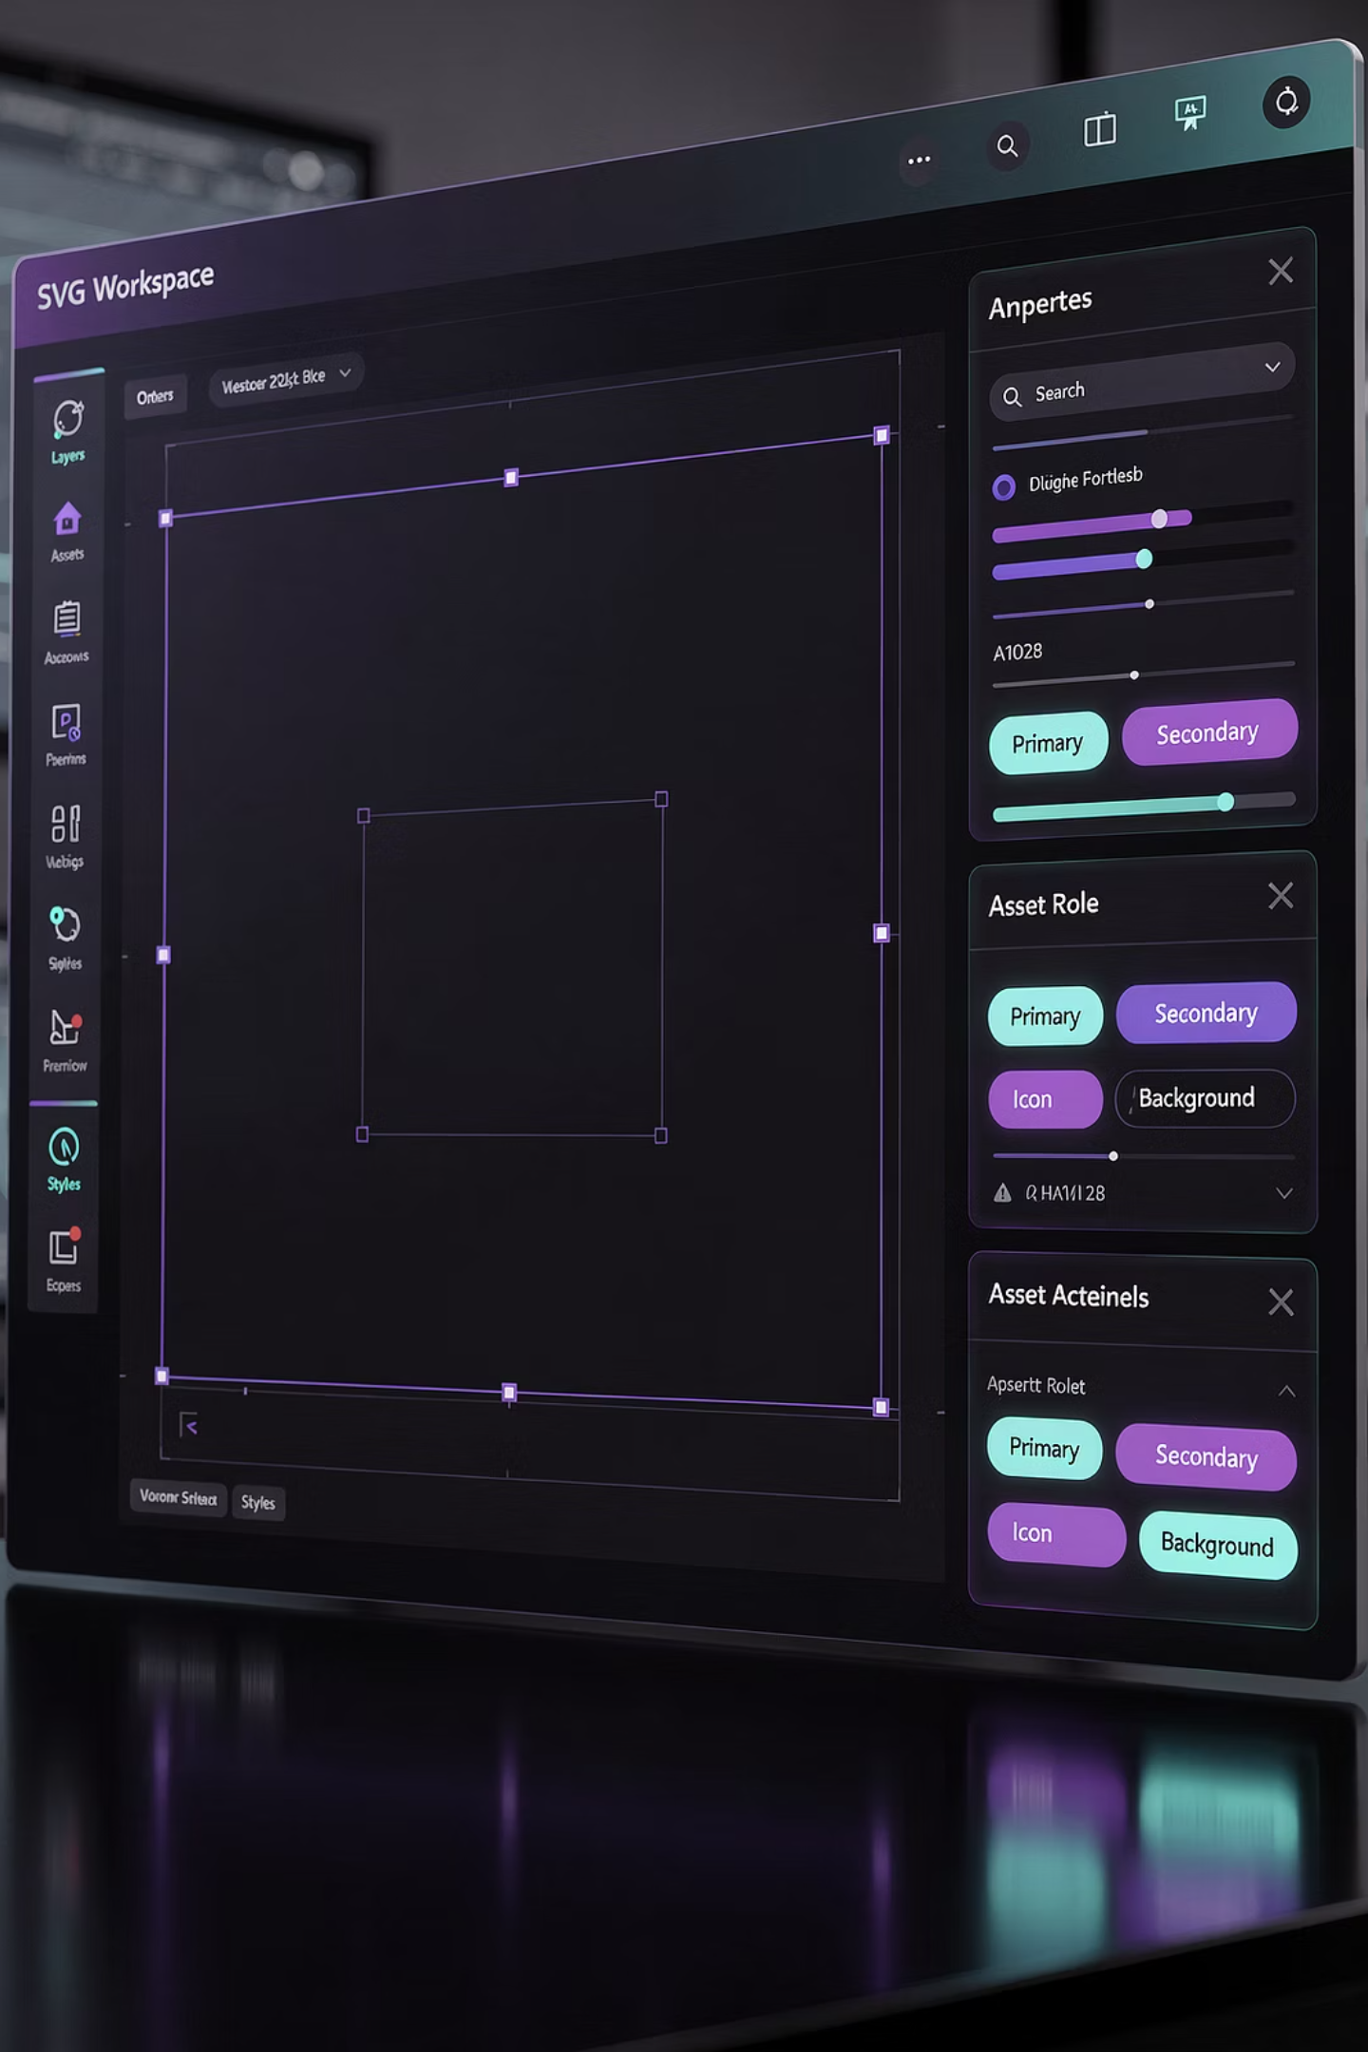
The asset & artifact Objects
asset — What the SVG Represents
artifact — Provenance of the Generated File
Describes the SVG's identity: id, role, title, description, ecosystem, and tags. Common roles include dataset-card, theme-board, pipeline-panel, stats-panel, logo, icon, and decorative.
Describes the SVG as a compiled artifact: kind, artifact_id, source_type, source_id, template_id, output_path, and build_profile (dev / preview / production).

Slide 9
The theme Object & NIPC Semantic Colors
The theme object describes the visual theme and semantic color mapping. For Aptlantis Studio, palette semantics come from the NeonInkPaletteContract (NIPC).
Clarity / Orientation
Trust / Validation
info, structure, navigation — Understanding and wayfinding
success, verified, stable — Evidence-backed confidence
Risk / Constraint
Creation / Build / Code
critical, error, blocked — Failure, blockers, hard limits
code-heat, build, tooling — Rust, execution, generated output

Slide 10
The ui Object — Runtime Placement Hints
The ui object provides hints for runtime placement and layout. These are hints, not requirements.
Key Fields
Interaction Hints
component_type: panel, card, badge, hero, graph-node
preferred_layout: artifact-card, logo-left-text-right, centered
preferred_regions / avoid_regions
responsive_behavior: preserve-aspect-ratio, crop-safe, scale-to-fit
click_target: canonical_html
hover_behavior: show-metadata
supports_focus: true/false
Dimensions
Intended width, height, and aspect_ratio for the rendered component.

Slide 11

crawl & llm Objects
crawl — Indexing & Archival Hints
indexable and archive booleans signal intent. discover_paths lists related paths worth crawling. canonical_group provides logical grouping (e.g., datasets, themes, pipelines). SESM does not replace robots.txt — crawlers must still respect host policy.
llm — Language Model Context
summary provides a short description. intended_interpretation clarifies what the asset represents. prompt_hints guide LLM context-building. avoid_interpretations prevents common agent mistakes. Prefer explicit SESM fields over visual color inference.

Slide 12
links, provenance & integrity
links
provenance
integrity
Connects the SVG to related resources: canonical_html, jsonld, manifest, download, torrent, source_repo, license, snapshot_hashes.
Records how the SVG was generated: generator name/version/language, generated_at (ISO-8601), input_records, reproducible flag, optional git_commit and build_id.
Non-secret integrity metadata: content_hash (e.g., blake3-256), path to manifest and signed_manifest. Not a replacement for signed manifests — prefer linking over embedding large signatures.

Slide 13

The extra Object & Vendor Extensions
The extra object is a namespace for platform-specific extensions. Vendor extensions must be namespaced to avoid collisions.
{
"extra": {
"vendor": {
"aptlantis": {
"schema_id": "DatasetCard",
"schema_version": "1.0.0",
"platform": "aptlantis-studio",
"domain": "www.aptlantis.studio"
}
}
}
}
Recommended pattern: always nest under extra.vendor.{organization_or_platform_name} to prevent field collisions with future SESM versions.

Slide 14
Embedding SESM in SVG
SESM metadata must be embedded inside an SVG <metadata> element with id="sesm". Only one SESM block per SVG. Agents parse the first and ignore the rest.
CDATA Form (Recommended)
Raw JSON Form
Use when templates are processed by XML-aware tools or special characters may appear in JSON strings.
Acceptable when the toolchain safely preserves the JSON without XML escaping issues.
<metadata id="sesm"><![CDATA[
{
"sesm_version": "0.2.0",
"asset": { "role": "dataset-card" }
}
]]></metadata>
<metadata id="sesm">
{
"sesm_version": "0.2.0"
}
</metadata>

Slide 15
Aptlantis Studio: Dataset Card Example
A real-world SESM block for the Rust Code Corpus dataset card, combining asset identity, artifact provenance, Neon Ink theme, UI hints, crawl permissions, and LLM context in a single embedded JSON object.
1
2
asset
artifact
id: rust-code-corpus-card, role: dataset-card, tags: rust, fine-tuning, small-models
kind: compiled-svg, source: datasets.jsonl, template: dataset-card-v1, build: production
3
4
theme
llm
Neon Ink v0.1, dark mode, accent: code-heat #F97316, state: active, glow: soft
Summary: curated Rust fine-tuning dataset. Hint: prefer SESM state fields over visual color inference.

Slide 16
Aptlantis Studio: Theme Board Example
The Neon Ink Theme Board SVG uses SESM to document the full palette and semantic family structure of the Aptlantis Studio visual system.
Token Palette
Semantic Families
void #050816, base #0B0F1A, panel #111827, info #22D3EE, process #A78BFA, featured #F472B6, success #34D399, important #FACC15, critical #F43F5E, code-heat #F97316
Nine families: clarity-orientation, trust-validation, attention-learning-anchor, risk-constraint, process-transformation, creation-build-code, discovery-creative-featured, research-experimental, canonical-archive-neutral.

Slide 17

Validation Rules & Agent Behavior
Recommended Validation Checks
Agent Behavior
SVG contains <metadata id="sesm">
Contents parse as valid JSON
sesm_version exists and is a string
Known top-level fields are objects
URLs are strings; hex colors follow #RRGGBB
crawl.indexable and provenance.generated are booleans
No obvious secret-like fields present
Locate and extract <metadata id="sesm">
Parse contents as JSON; check sesm_version
Use known fields; ignore unknown fields
Prefer explicit SESM fields over visual inference
Use links.canonical_html for full page context
Use llm.summary and prompt_hints to avoid guessing
Validators should warn, not fail, for unknown fields.

Slide 18


Security & Privacy Considerations
SESM is descriptive, not protective. Assume SESM blocks may be mirrored, scraped, indexed, archived, exposed to LLMs, or copied outside their original context.
Never Embed
API keys, tokens, private URLs, credentials, unreleased project names, private filesystem paths, personal information, or internal-only notes.
Keep Private Behavior In
Backend configs, signed manifests, and access control systems — not in SESM blocks that travel with the SVG file.

Slide 19

Build Pipelines, Rust Generators & Compatibility
Rust Generator
Compiled SVG Artifacts
JSON/JSONL Manifests
Static HTML Pages
The generator stamps each SVG with source record ID, template ID, generator name/version, timestamp, canonical output path, theme ID, semantic state, and crawl/LLM hints. SESM v0.2 remains backward-compatible with v0.1-style blocks — agents must not require every v0.2 field to be present.

Slide 20

Summary: SVGs Are Self-Describing Artifacts
SESM is an intentionally simple convention: a valid JSON object embedded inside

